Slide 1



Chapter -1,5,6
30th April 4.00PM.

Slide 2
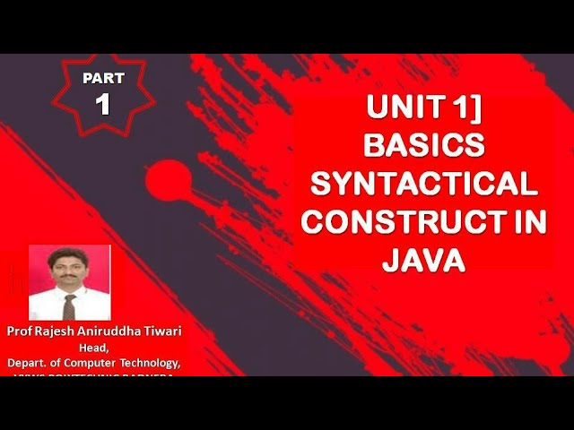
Weightage 10marks

Slide 3
Question1- Explain Any four Features of Java .(4) Or List any eight Features of Java(2M)
1.Simple
• JAVA is Easy to write and more readable and eye catching
• JAVA has a concise, cohesive set of features that makes it easy to learn and use.
• Most of the concepts are drawn from C++ thus making JAVA learning simpler
2.Object-Oriented
• JAVA programming is object-oriented programming language
• Like C++, JAVA provides most of the object oriented features
• JAVA is pure OOPS Language. (while C++ is semi object oriented).

Slide 4
3 .Dynamic
• JAVA programs carry with them substantial amounts of run-time type information that is used to verify and resolve accesses to objects at run time
4.Distributed
• JAVA was designed with the distributed environment
• JAVA can be transmit, run over internet
5.Platform Independent
Java has implemented ‘write once run anywhere’ known as platform independent strategy.
Program written on one platform can run on another platform.
Changes and upgradation in operating system does not affect program at run.
6.High Performance
JAVA is an interpreted language, so it will never be as fast as a compiled language like C or C++. But, JAVA enables high performance with the use of just-in-time compiler

Slide 5
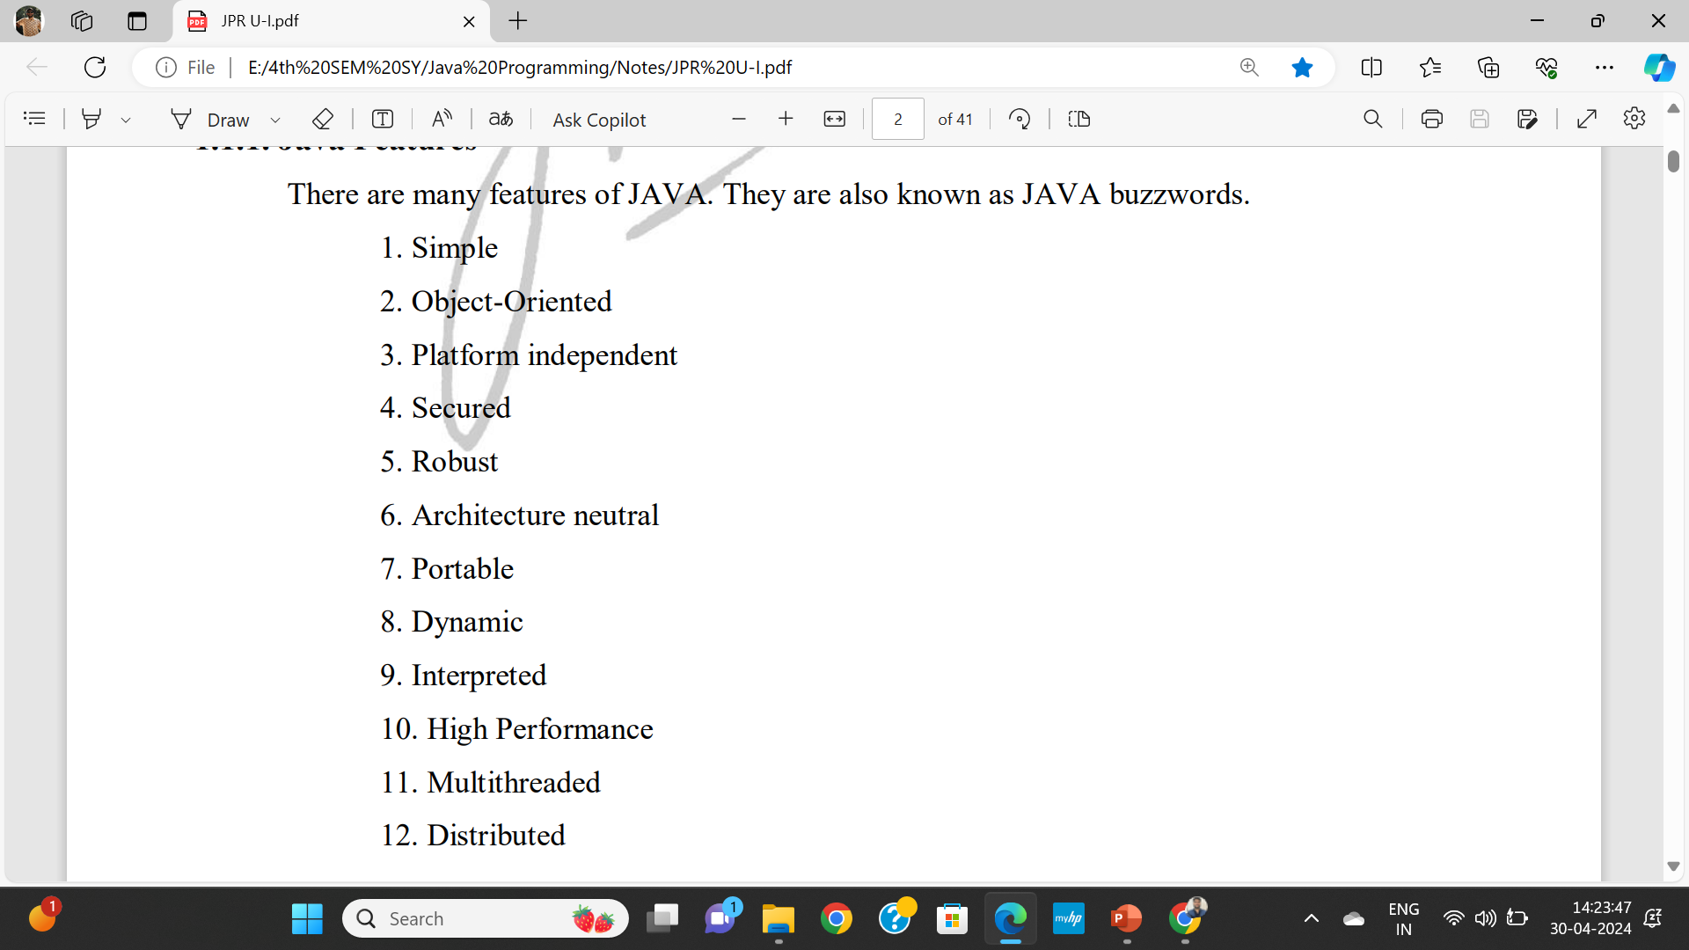

Slide 6
Question 2 : Define Class & Object(2marks)
Class – A class is a group of object that has common properties .It is blueprint from which object is created.
A class is a way of grouping objects having similar charachtertics. It is user defined data types which represents a group of similar objects.
Syntax
Class Classname
{
//datamembers;
//methods
}

Slide 7
Object
Object is instance of class . They are basic runtime entites .
A any real world object can be treated as object in java/oop/such as person,car…
An entity has state and behaviours is known as object.
Syntax for creating object
Classname objectname= new classname();

Slide 8
Question 3 : Type casting in Java(imp-4m)
1. The process of converting one data type to another is called casting or type casting.
2. If the two types are compatible, then java will perform the conversion automatically.
3. It is possible to assign an int value to long variable.
4. However, if the two types of variables are not compatible, the type conversions are not implicitly allowed, hence the need for type casting
There are two types of conversion: 1.Implicit type-casting
2.Explicit type-casting:

Slide 9
1. Implicit type-casting:
Implicit type-casting performed by the compiler automatically; if there will be no loss of precision.
Example: int i = 3;
double f;
f = i;
output: f = 3.0

Slide 10
2.Explicit type-casting:
• Explicit type-casting performed via a type-casting operator in the prefix form of (new-type) operand.
• Type-casting forces an explicit conversion of type of a value. Type casting is an operation which takes one operand, operates on it and returns an equivalent value in the specified type.
Syntax: newValue = (typecast)value;
Example: double f = 3.5; int i;
i = (int)f; // it cast double value 3.5 to int 3.

Slide 11
Widening Conversion: The rule is to promote the smaller type to bigger type to prevent loss of precision, known as Widening Conversion.
Narrowing Casting: Explicit type cast is requires to Narrowing conversion to inform the compiler that you are aware of the possible loss of precision.

Slide 12
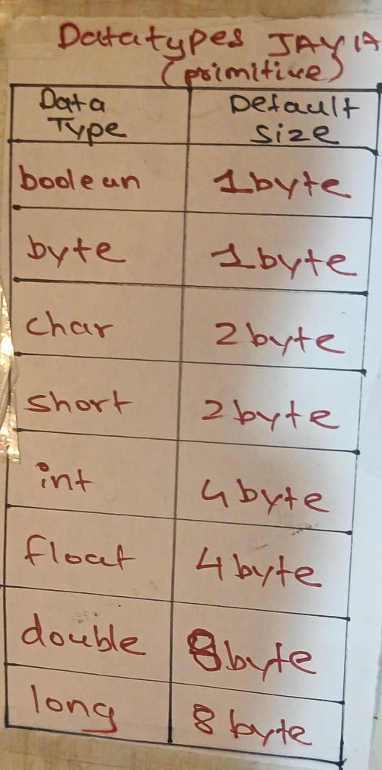
Question4 - Primitive Data types and its sizes.(4marks)
Primitive data types are simple and predefined types like integers and booleans, used for basic data storage, whereas non-primitive structures like arrays and lists are more complex, designed for organizing collections of data and enabling advanced data manipulation.
They are inbuilt and understood by compiler.

Slide 13
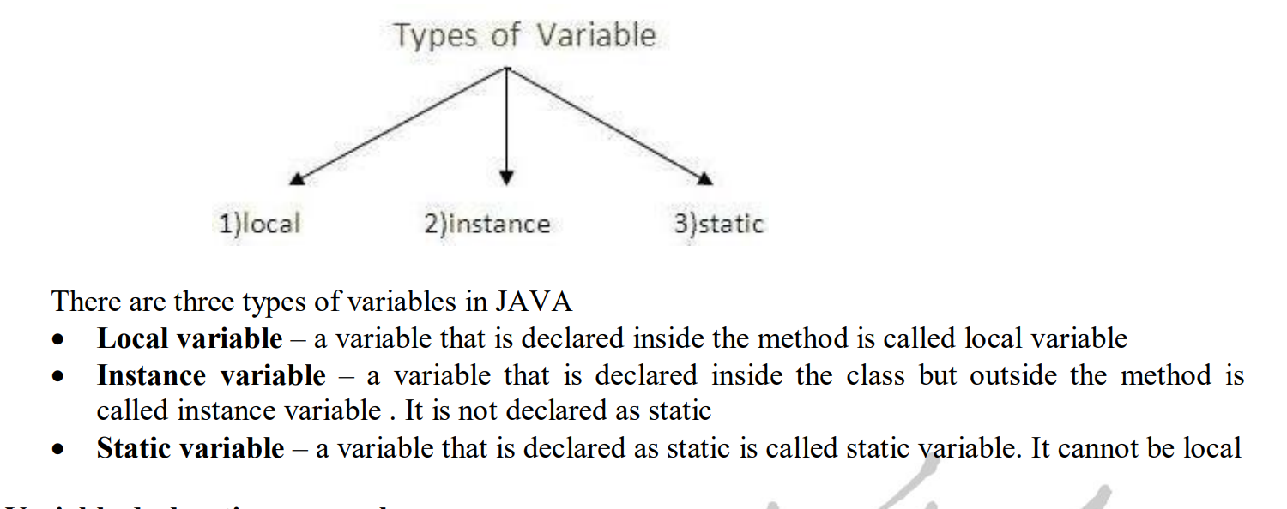
Question5. Scope of Variable
Variable is name of reserved area allocated in memory.
E.G. – int data = 50; // Here data is variable

Slide 14
Operators
Arithematics : +,-,*,/,%,^
Increment Decrement : ++,--
Relational operator : ==,!=,>,<,>=,<=
Logical : && || !
Bitwise : & >> << ^=
Assignment operator ;;; same all arithematic only (c+=a)…….c=c+a;
Math function ……syntax math.operator/function (value)
Example …. Math.power(3,5)

Slide 15
Decesion making and looping
Control structures …………….. Do while ,while,for loops
Decsison control……….if , if-else,nested if-else , if-else ladder,switch case,nested switch case
Juming statements ….. Goto …break…return…continue

Slide 16
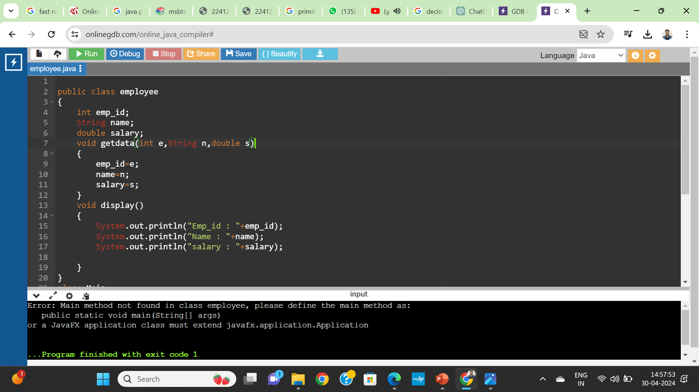
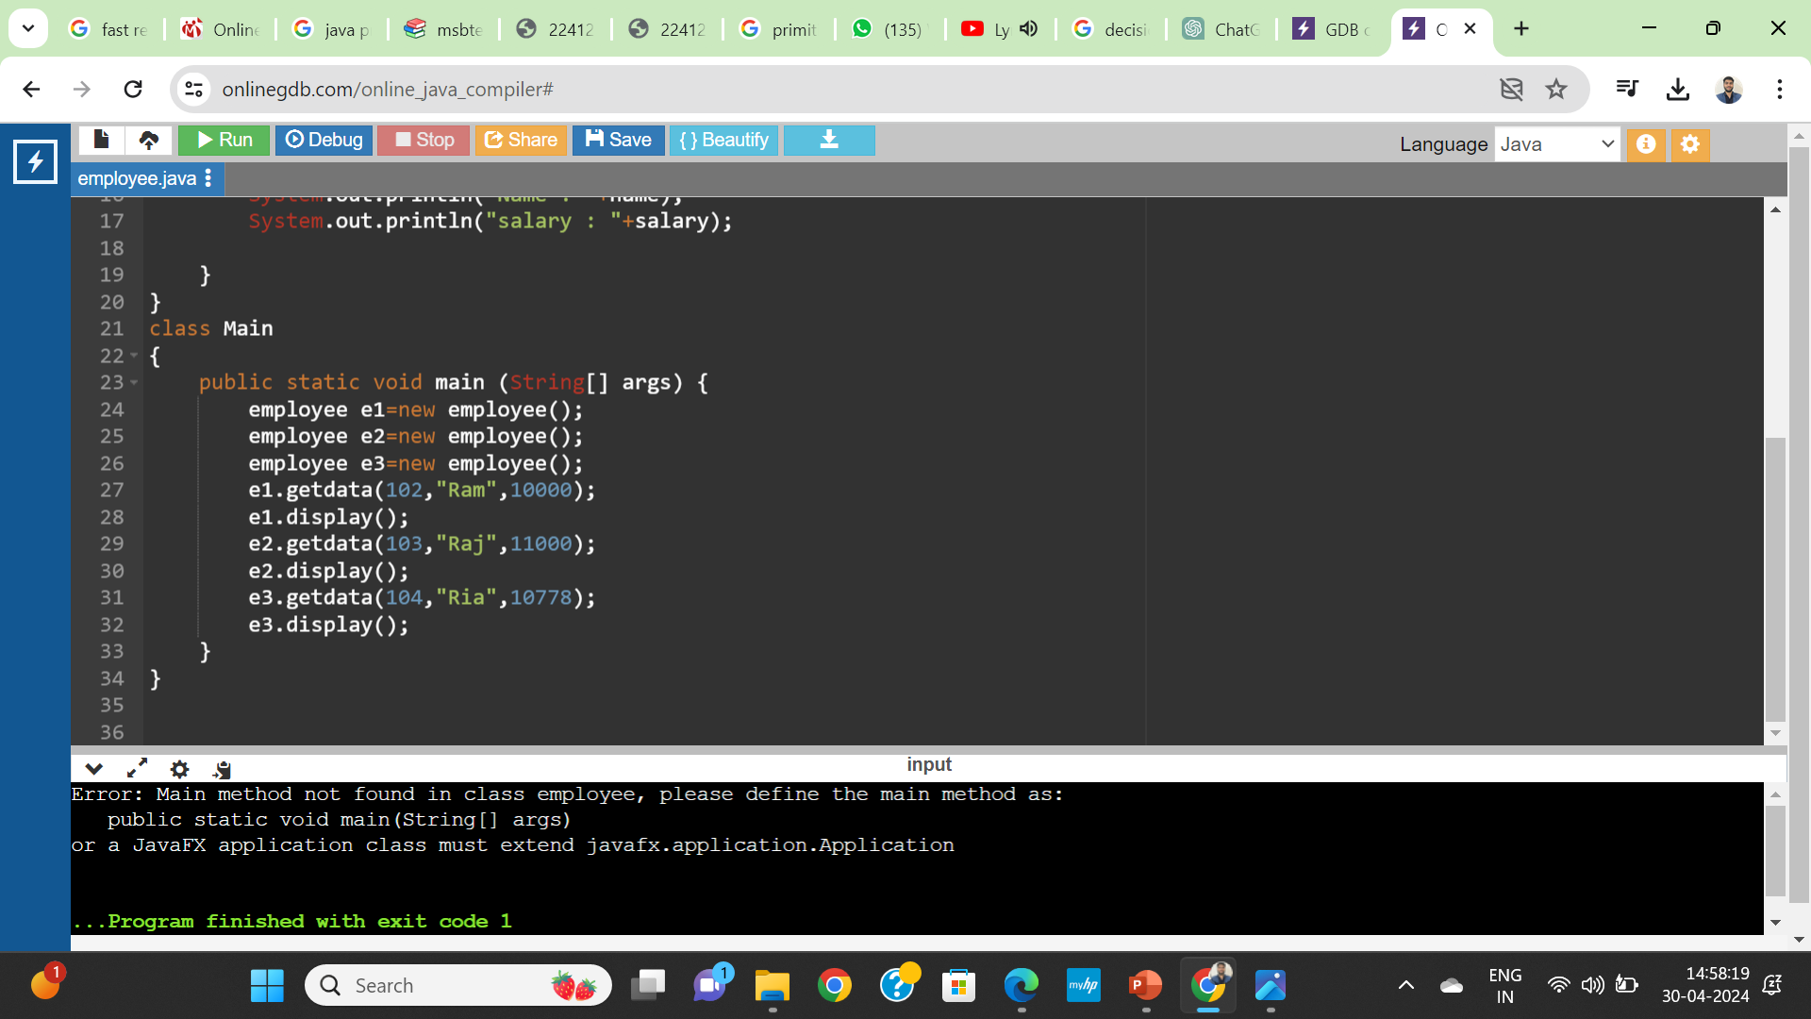
Define a class employee with data members ‘empid’, ‘name’ and ‘salary’. Accept data for three objects and display it.

Slide 17
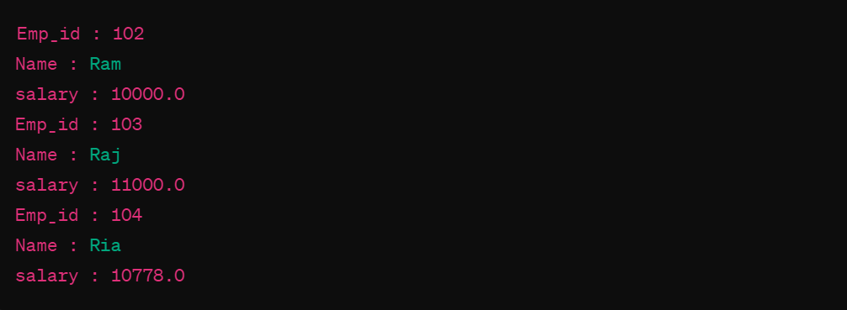
Output
Same Code as above –
Define a class circle having data members Pi and radius. Initialize and display values of data members also calculate area of circle and display it

Slide 18
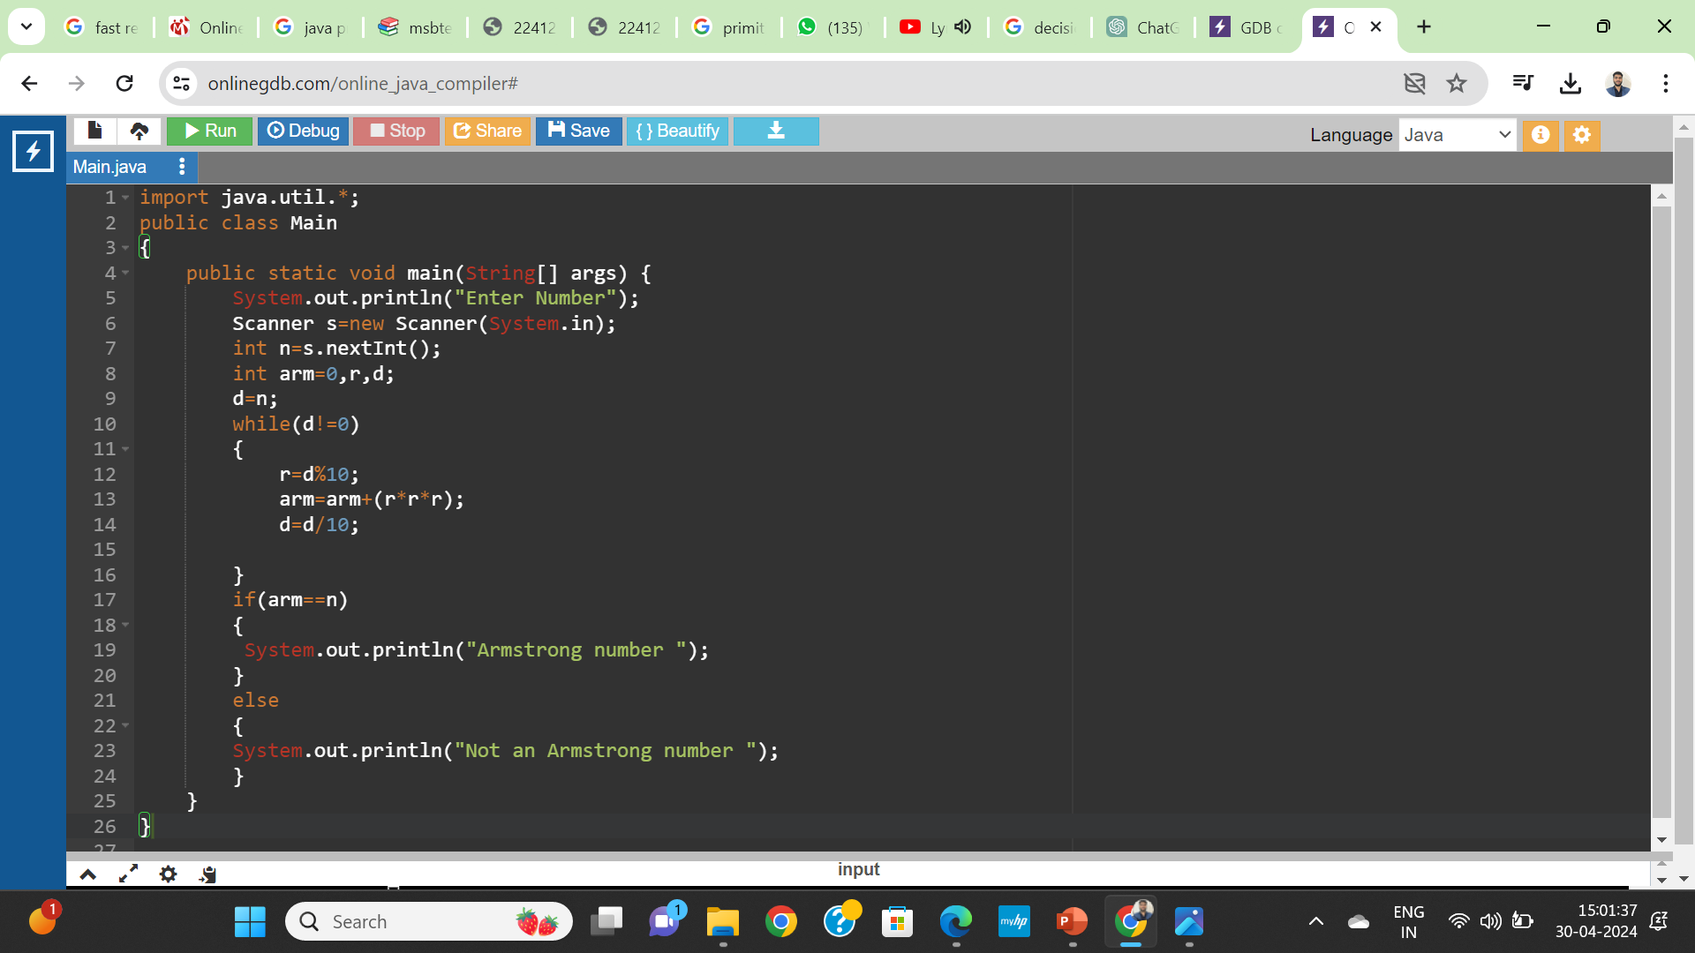
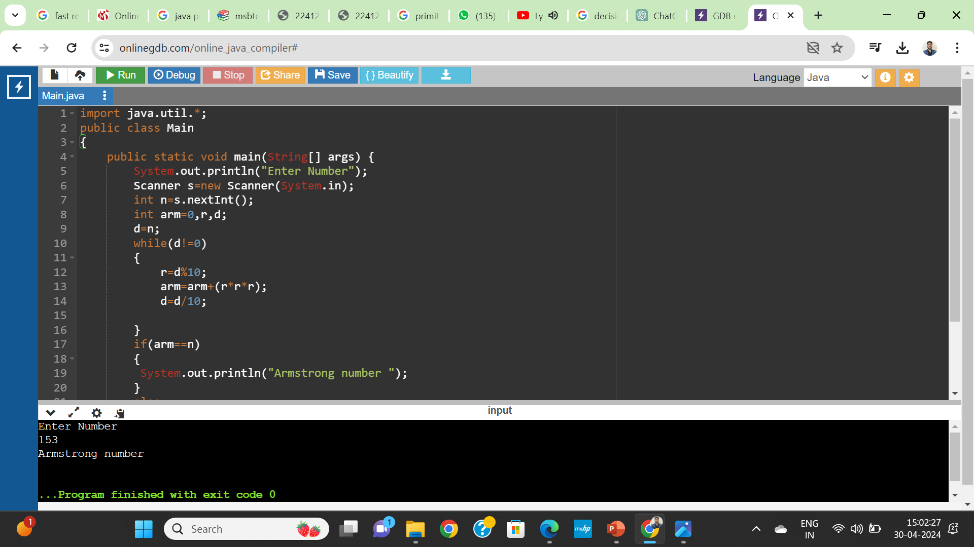

Armstrong no .

Slide 19
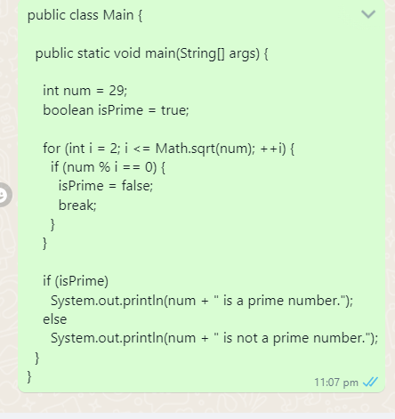
Prime no

Slide 20
Expected
Write a program to Find factorial of given number .
WAP for Fibonacci series for given number

Slide 21
Unit 5 :Java applets and Graphics programming
Weightage- 10marks

Slide 22
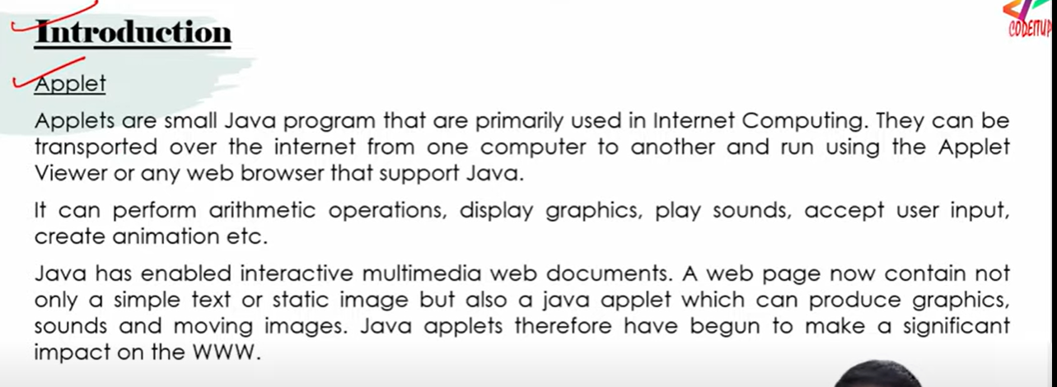

Slide 23
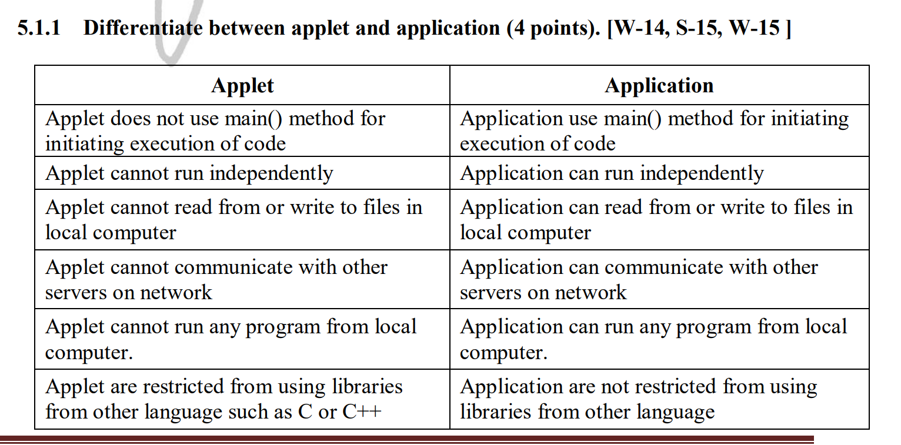

Slide 24
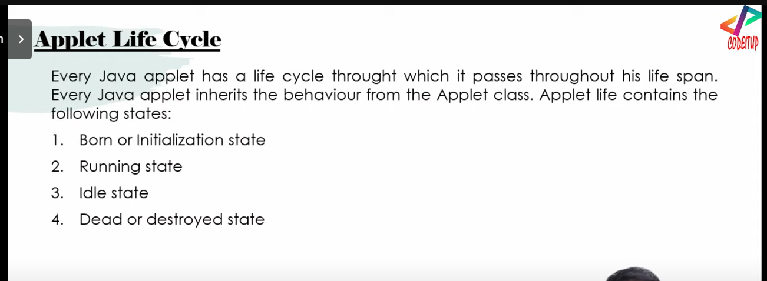

Slide 25
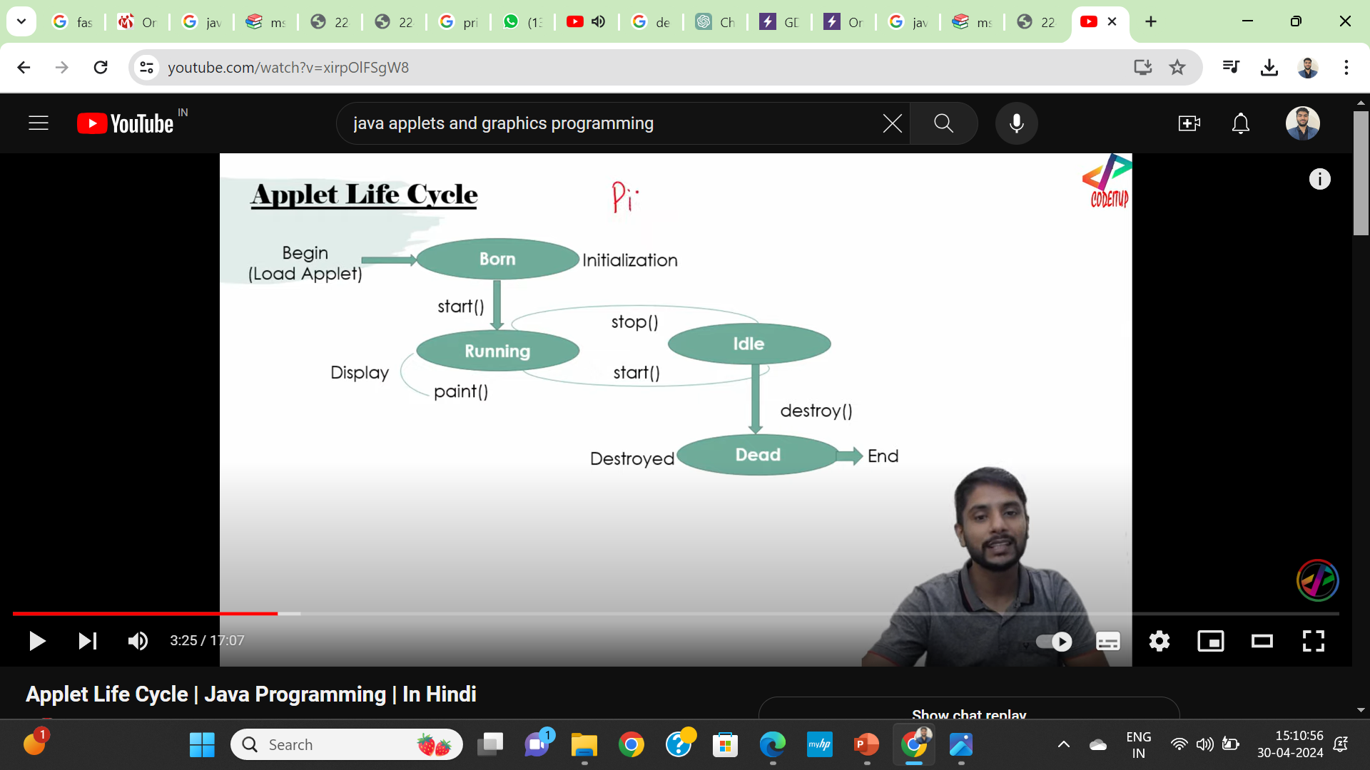

Slide 26
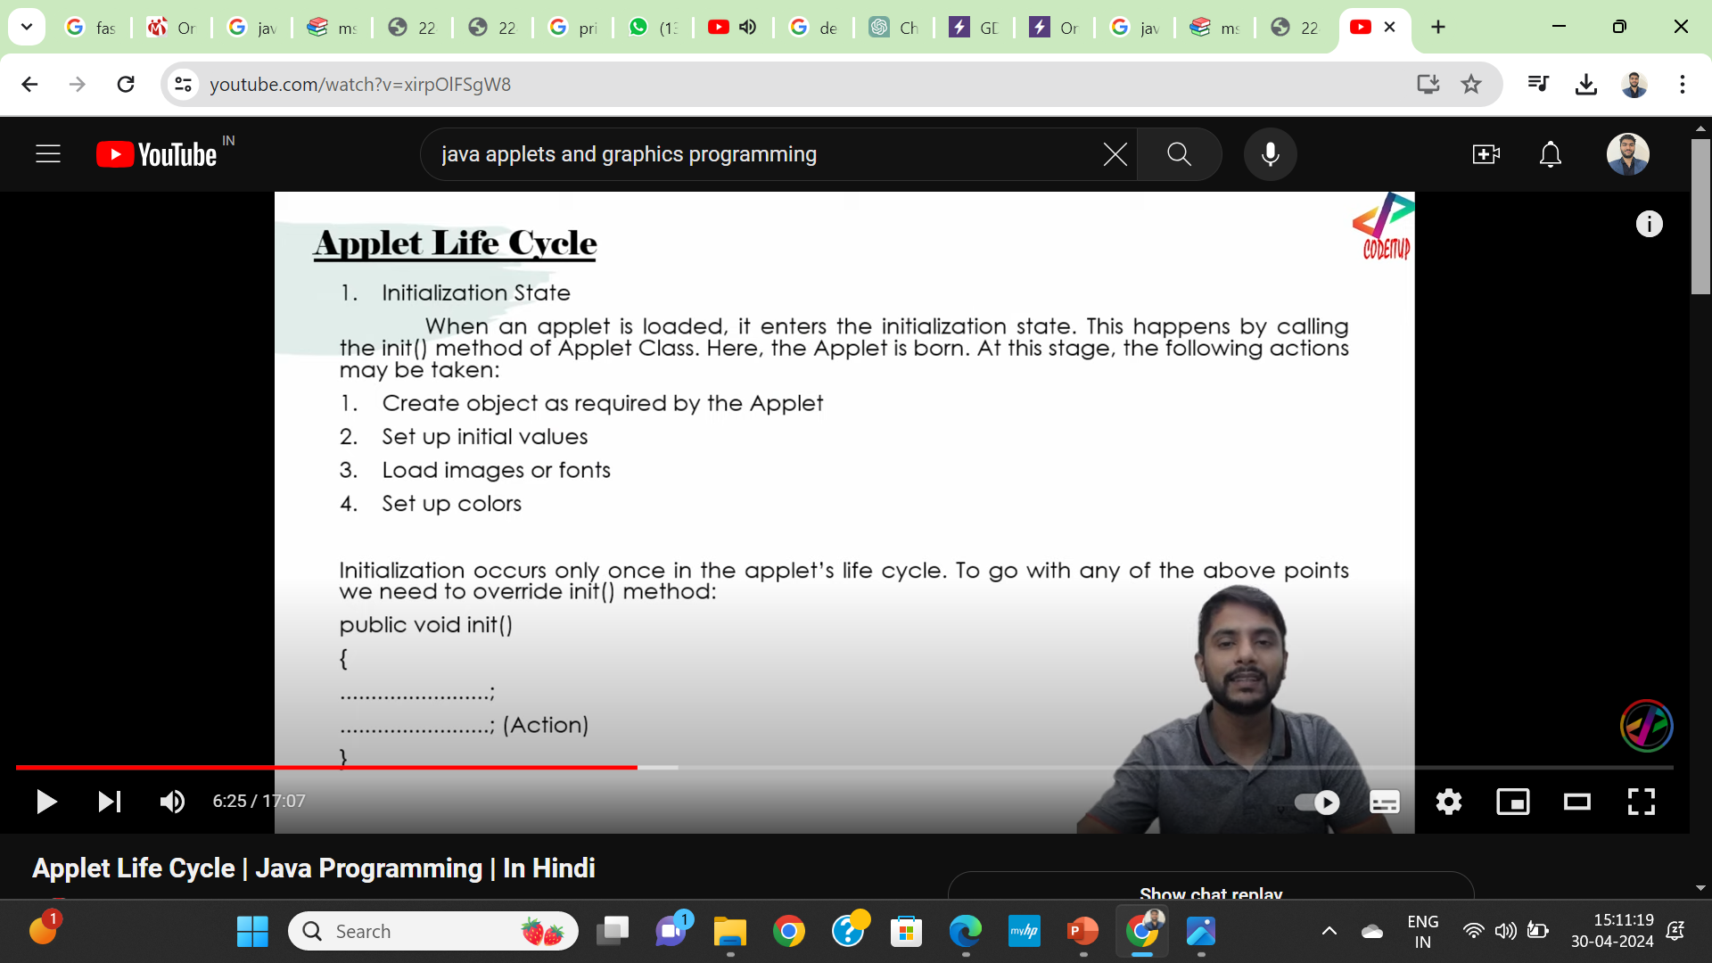

Slide 27
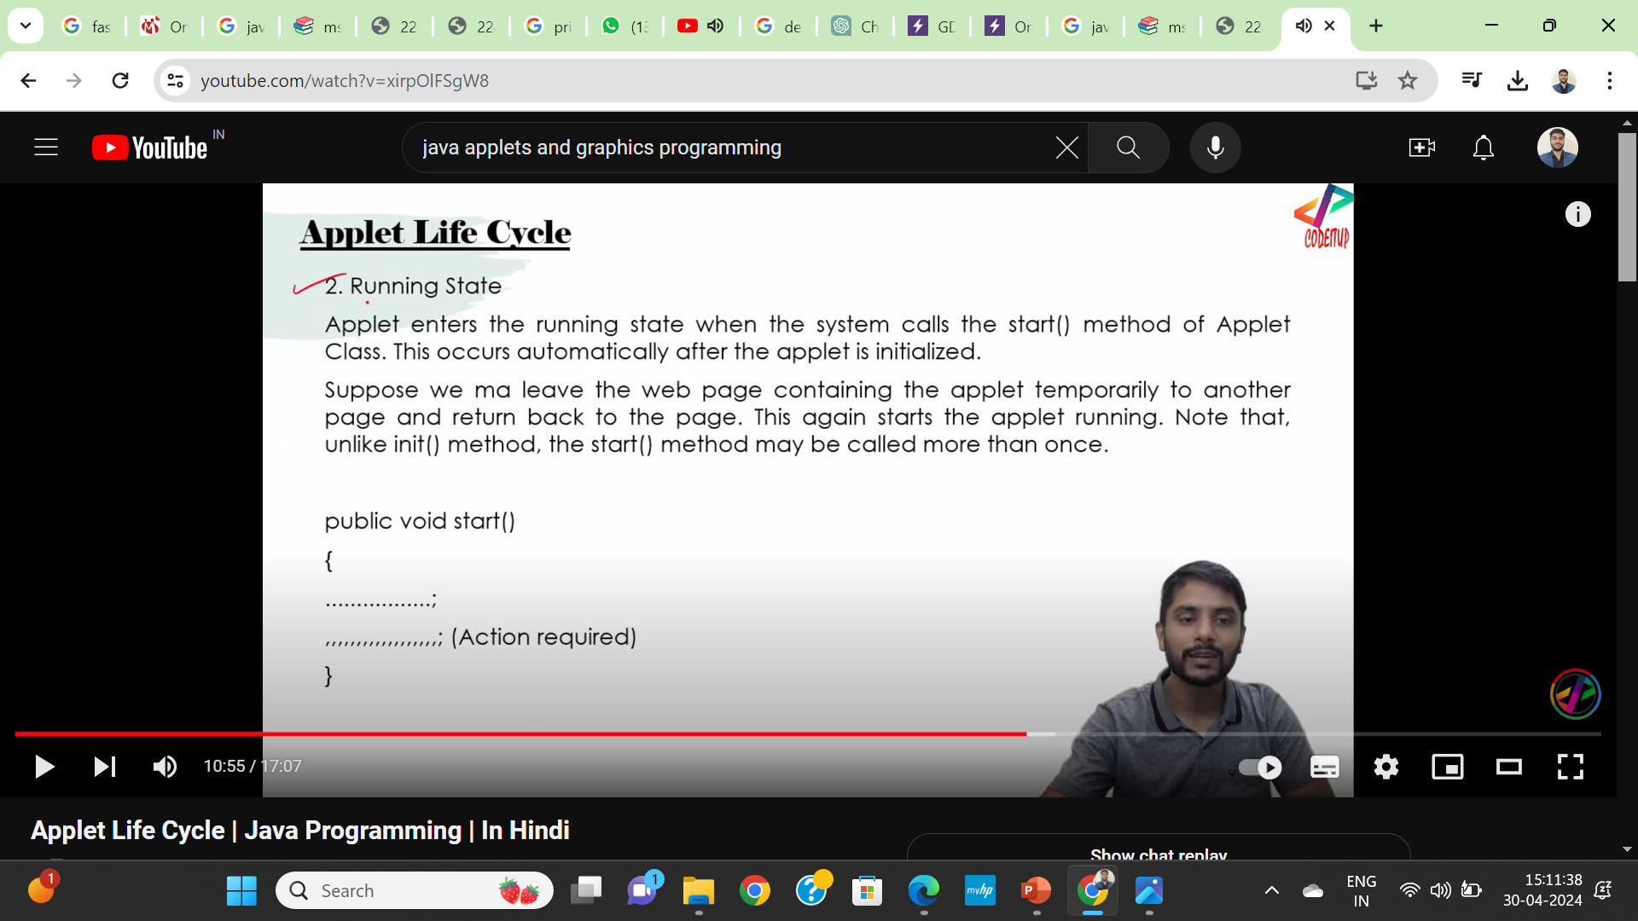

Slide 28
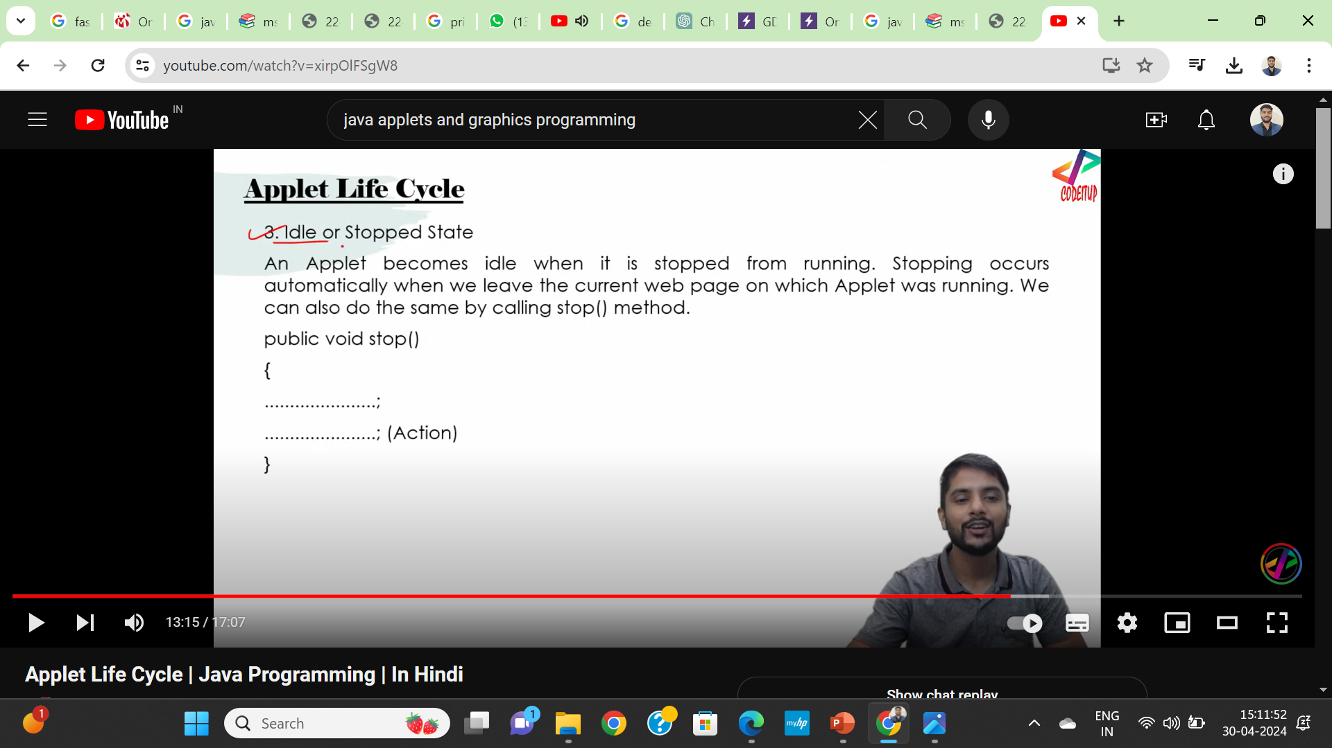

Slide 29
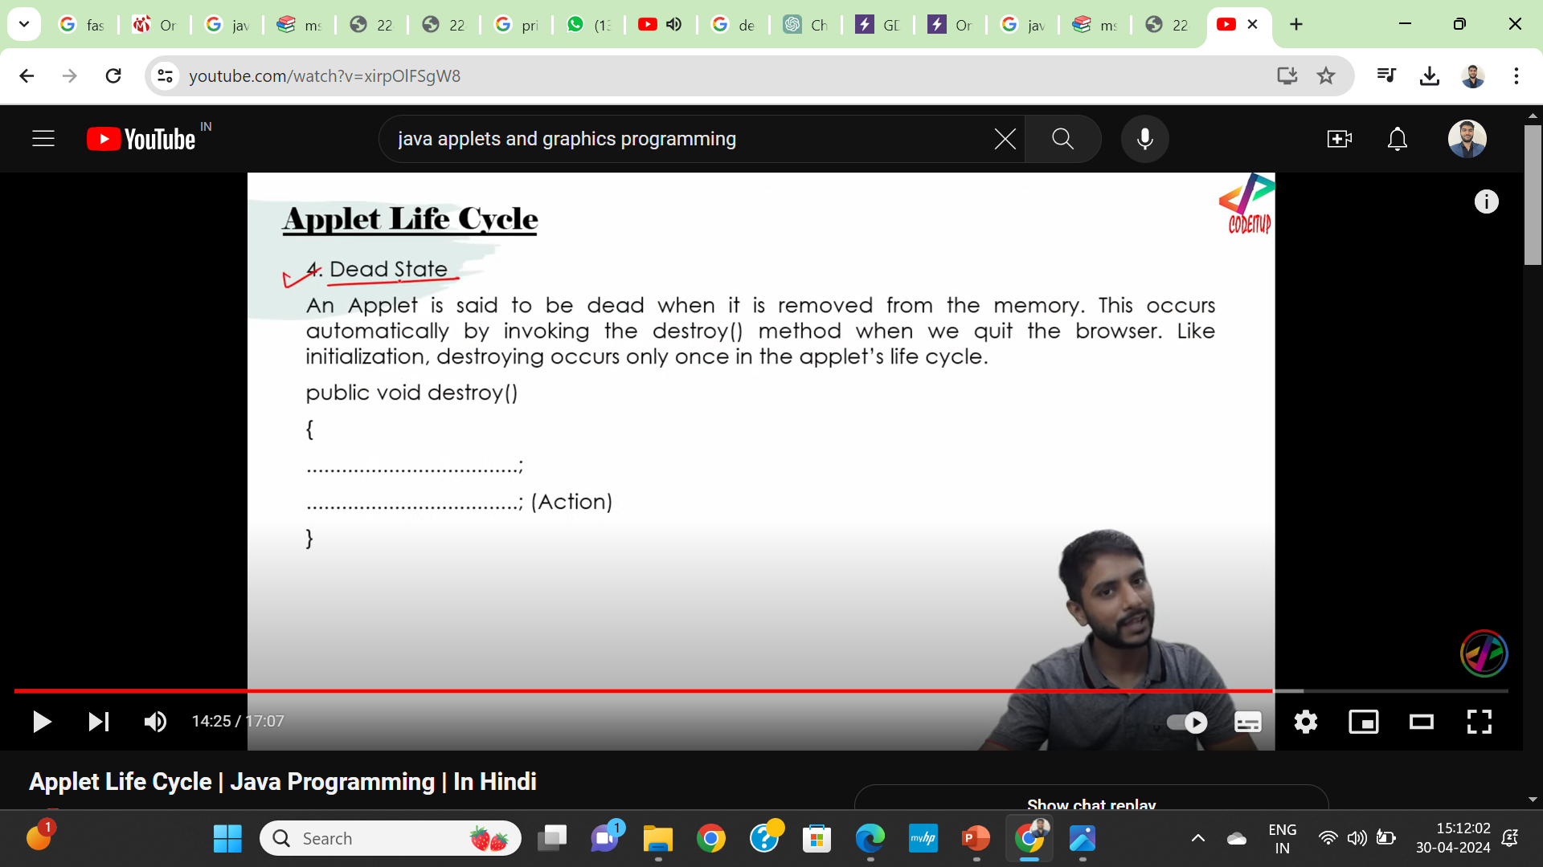

Slide 30
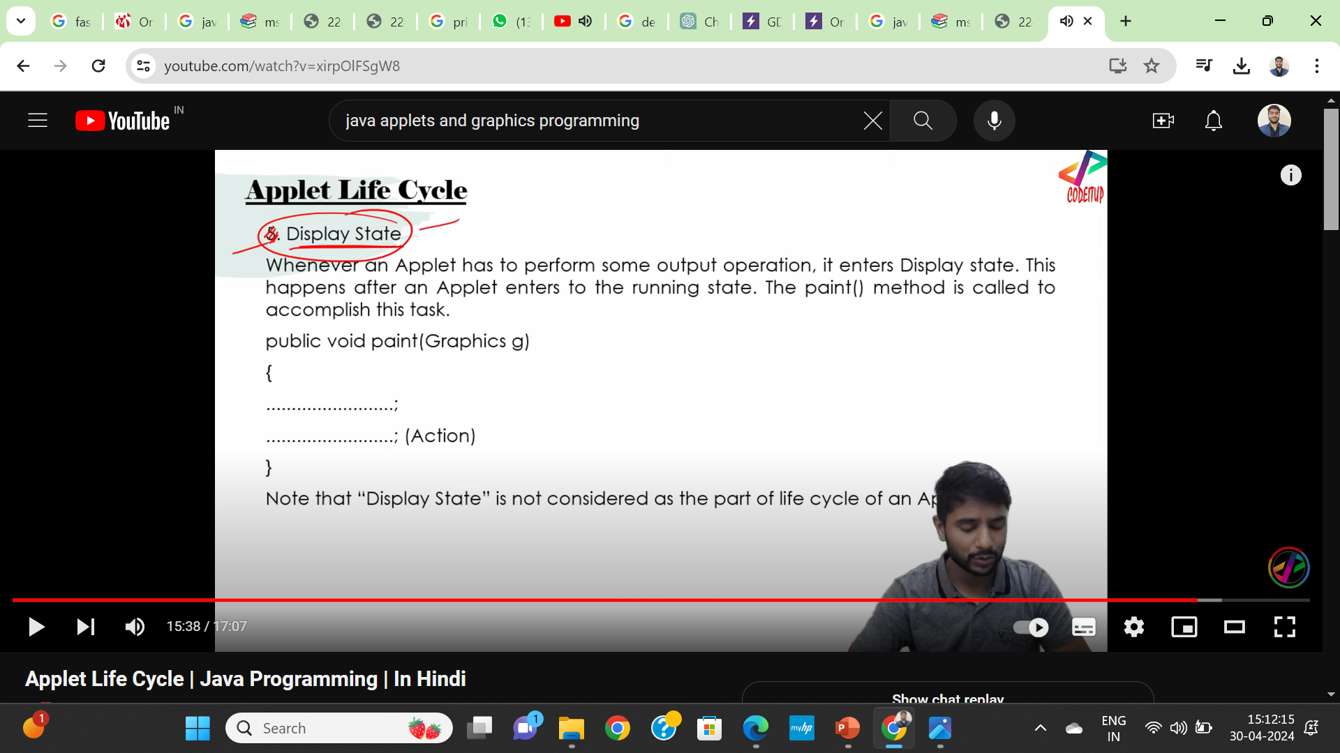

Slide 31
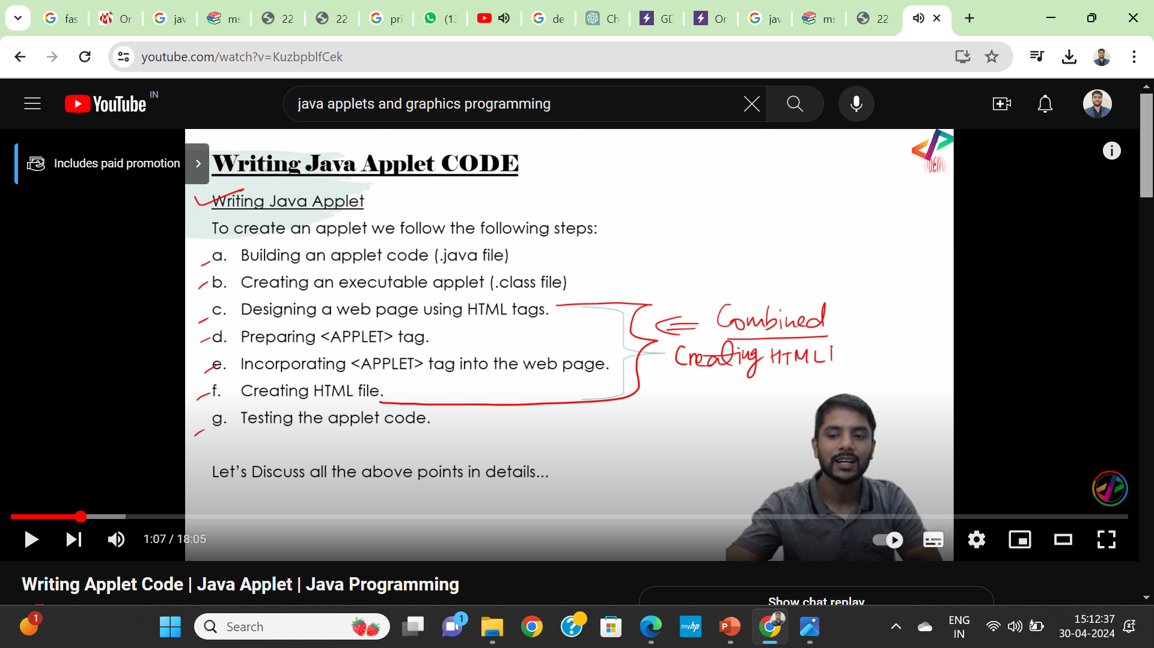

Slide 32
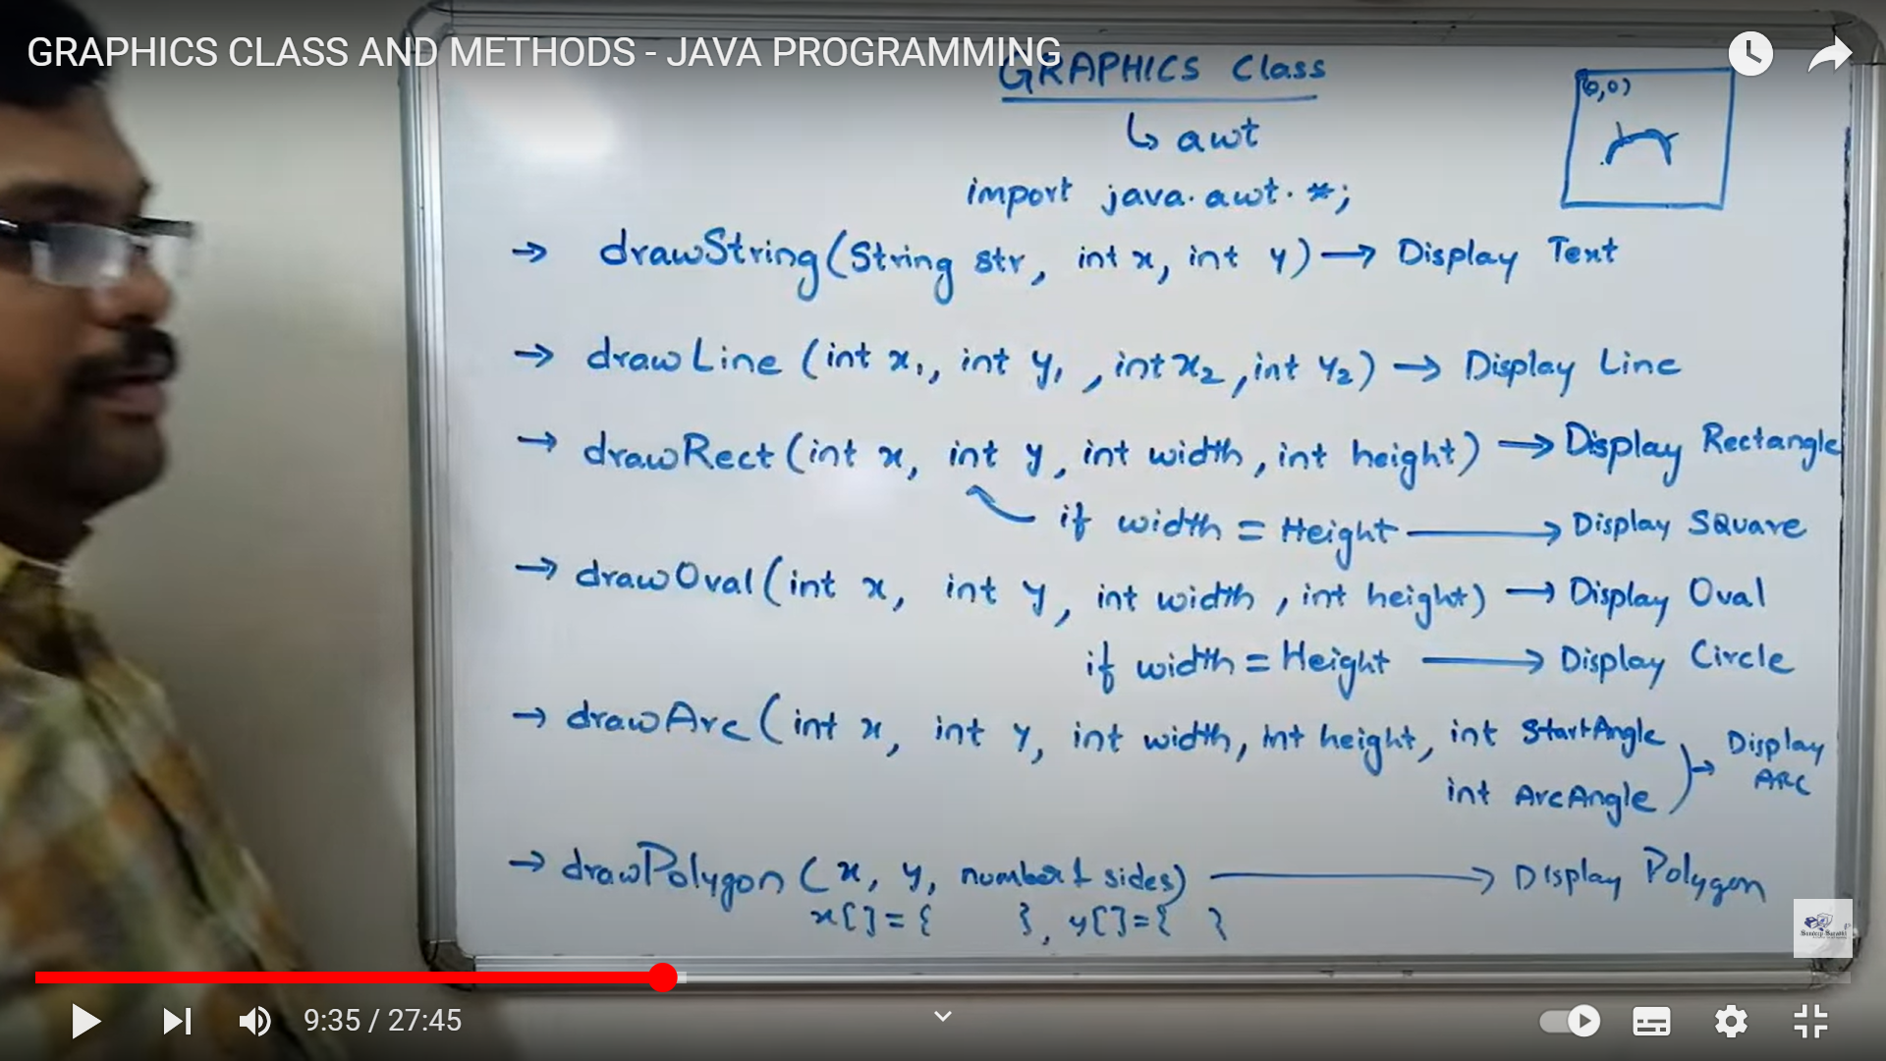

Slide 33
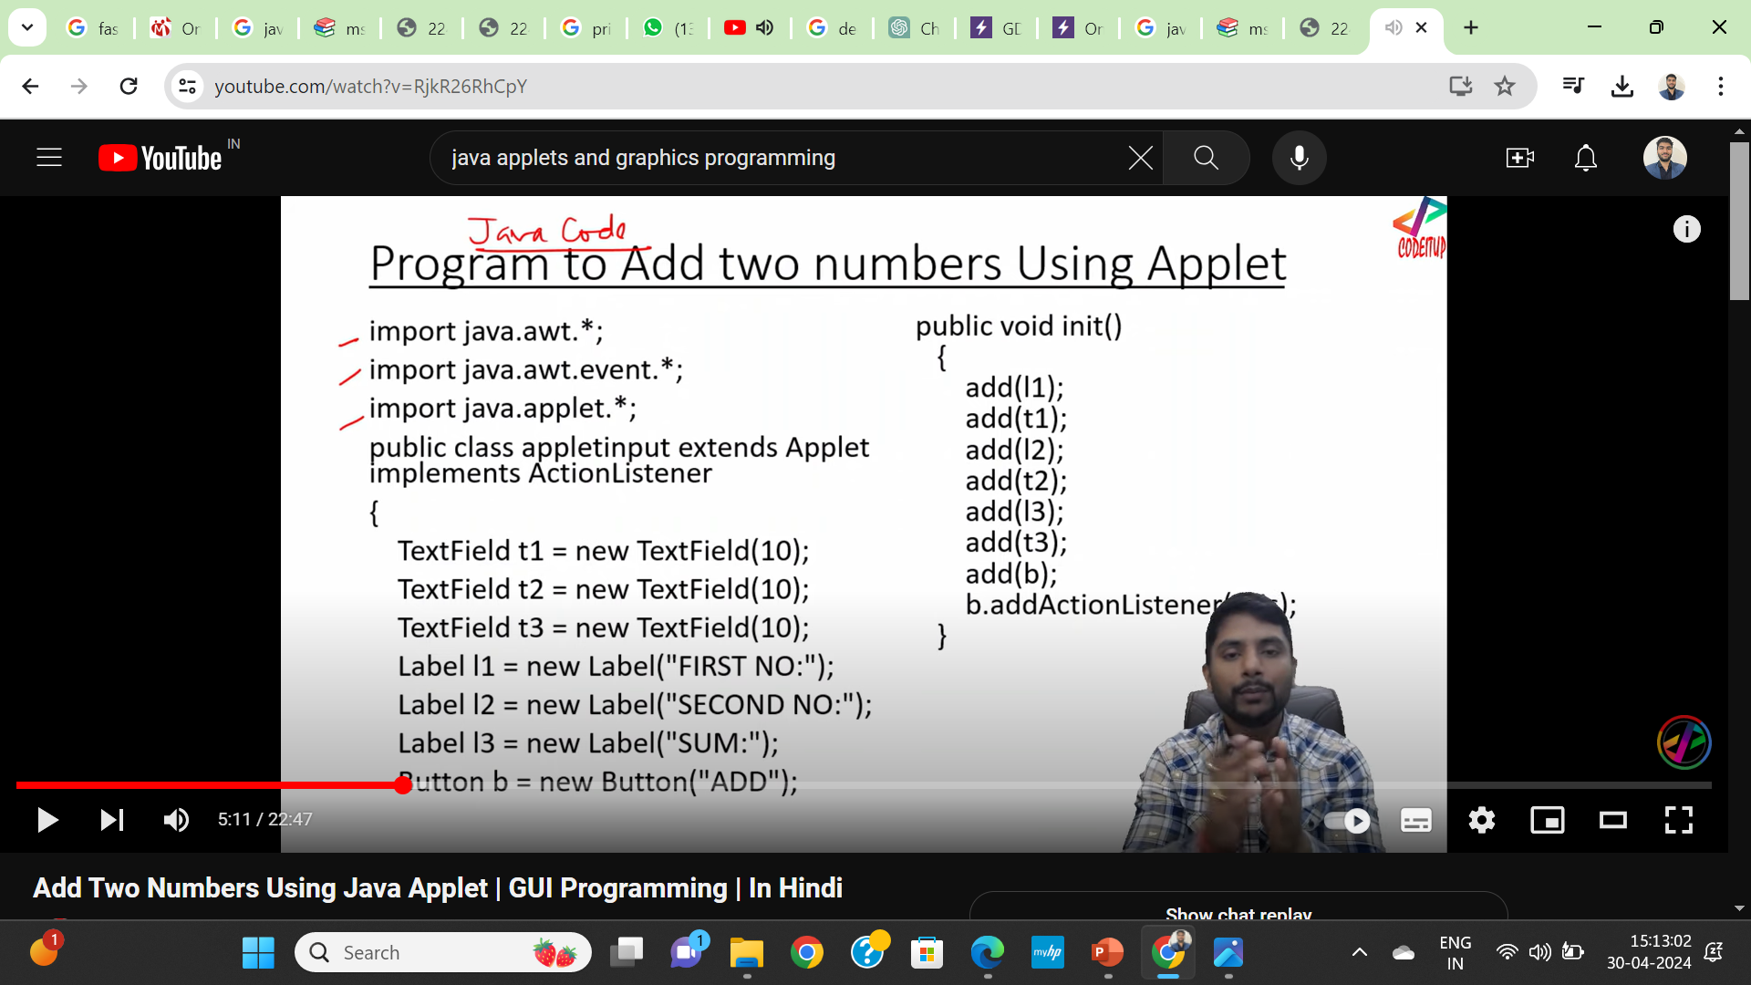

Slide 34
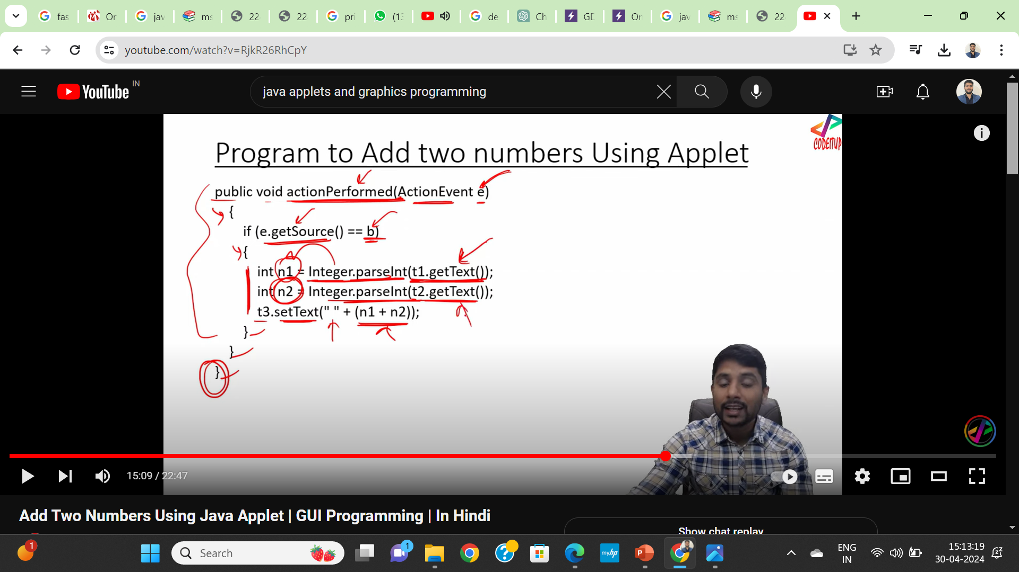

Slide 35
Solve
Design an applet to perform all arithmetic operations and display the result by using labels. textboxes and buttons

Slide 36
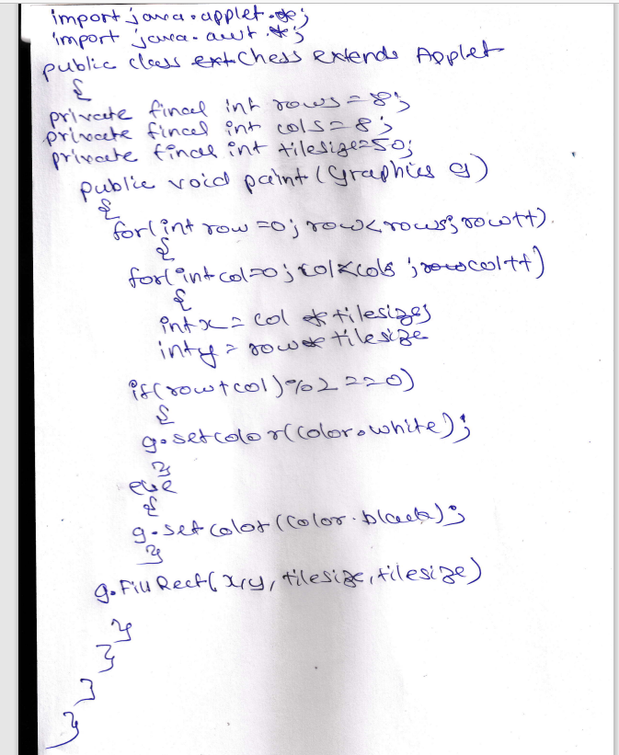
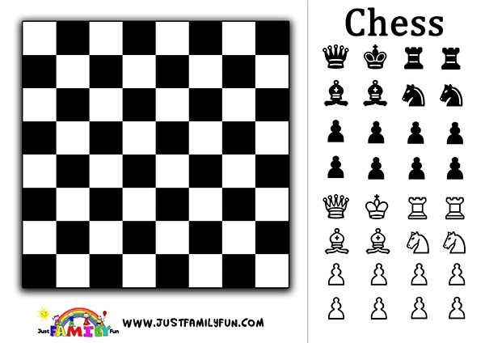

Slide 37
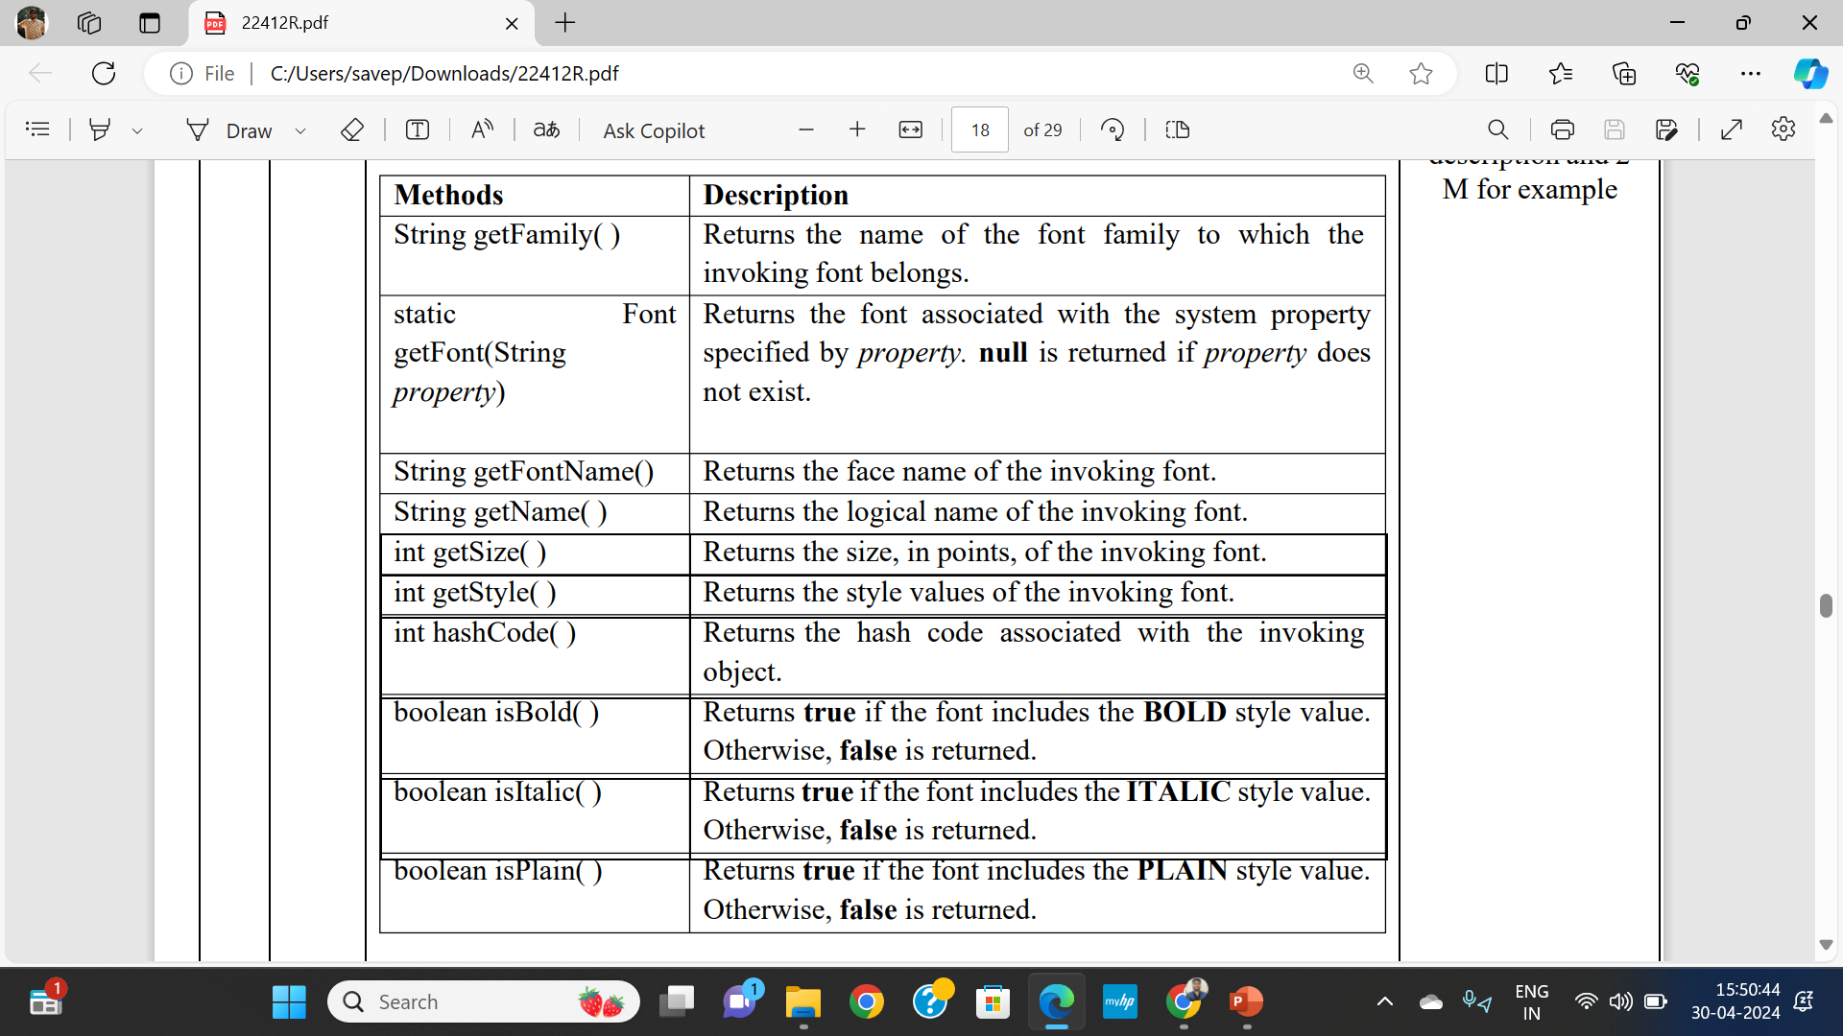

Slide 38
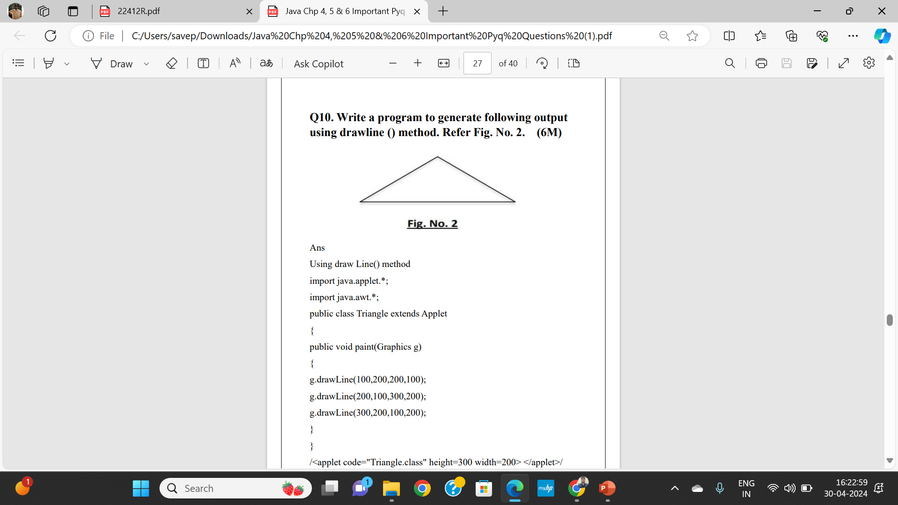

Slide 39
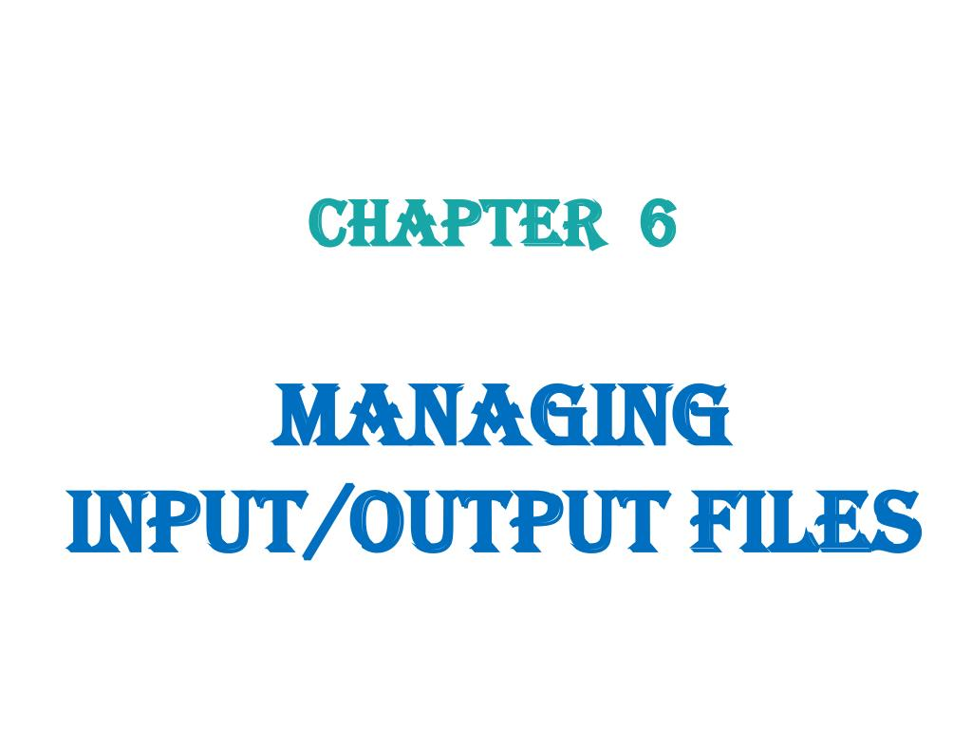
Weightage – 08 Marks

Slide 40
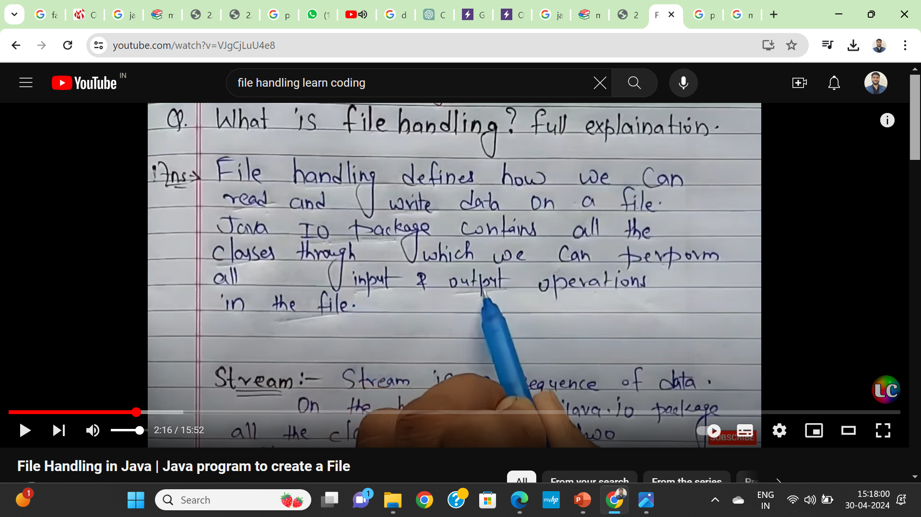

Slide 41
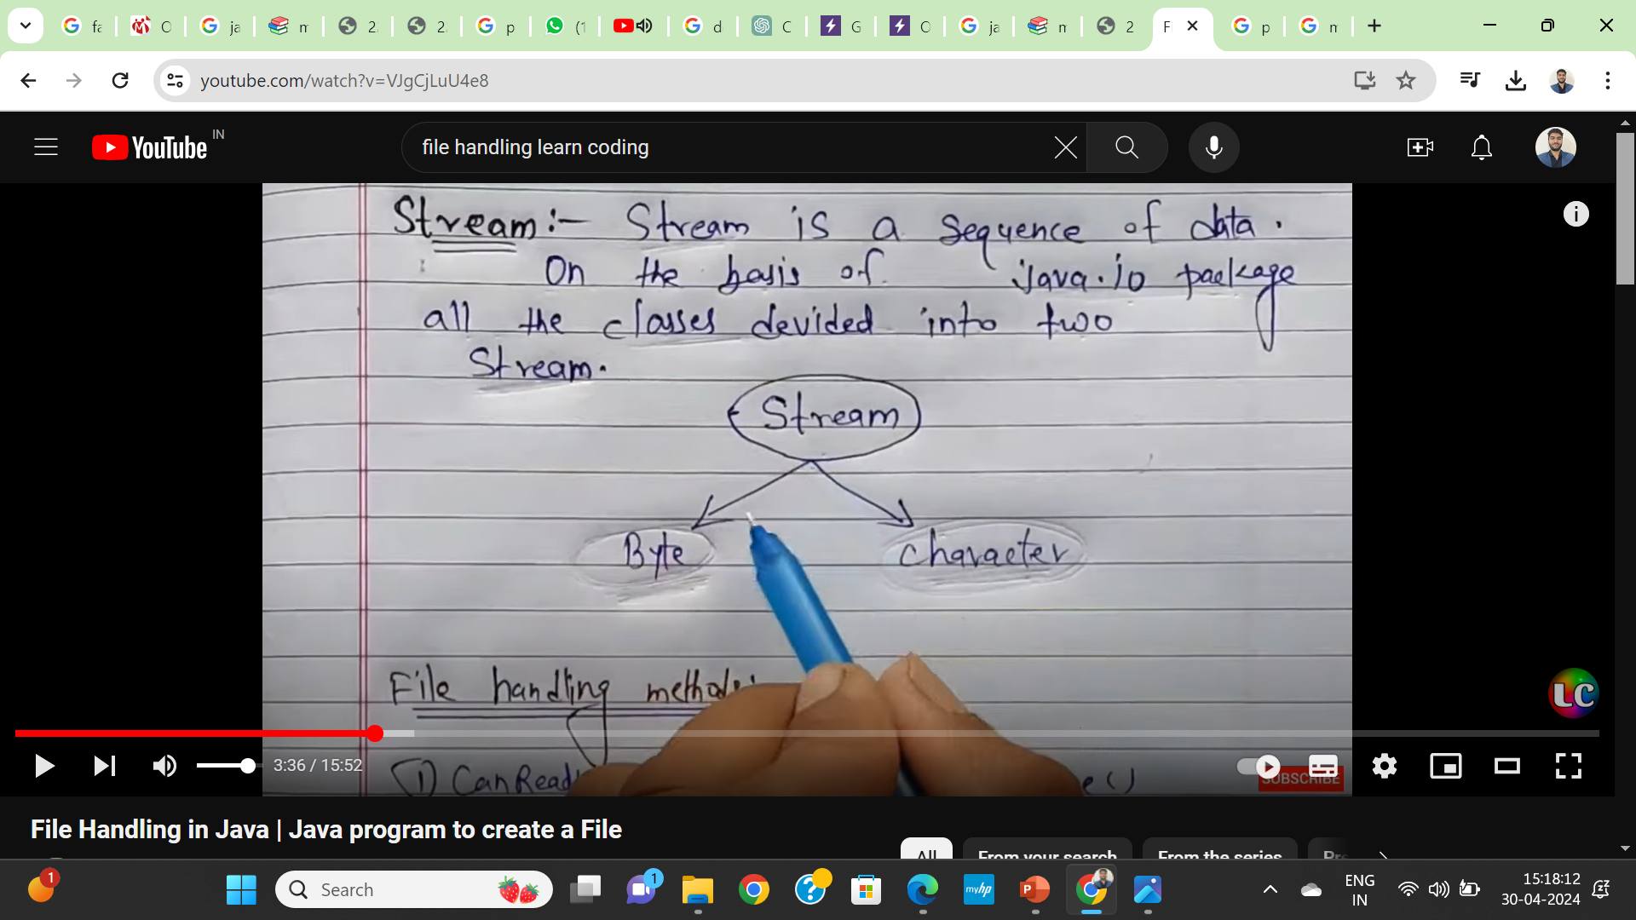

Slide 42
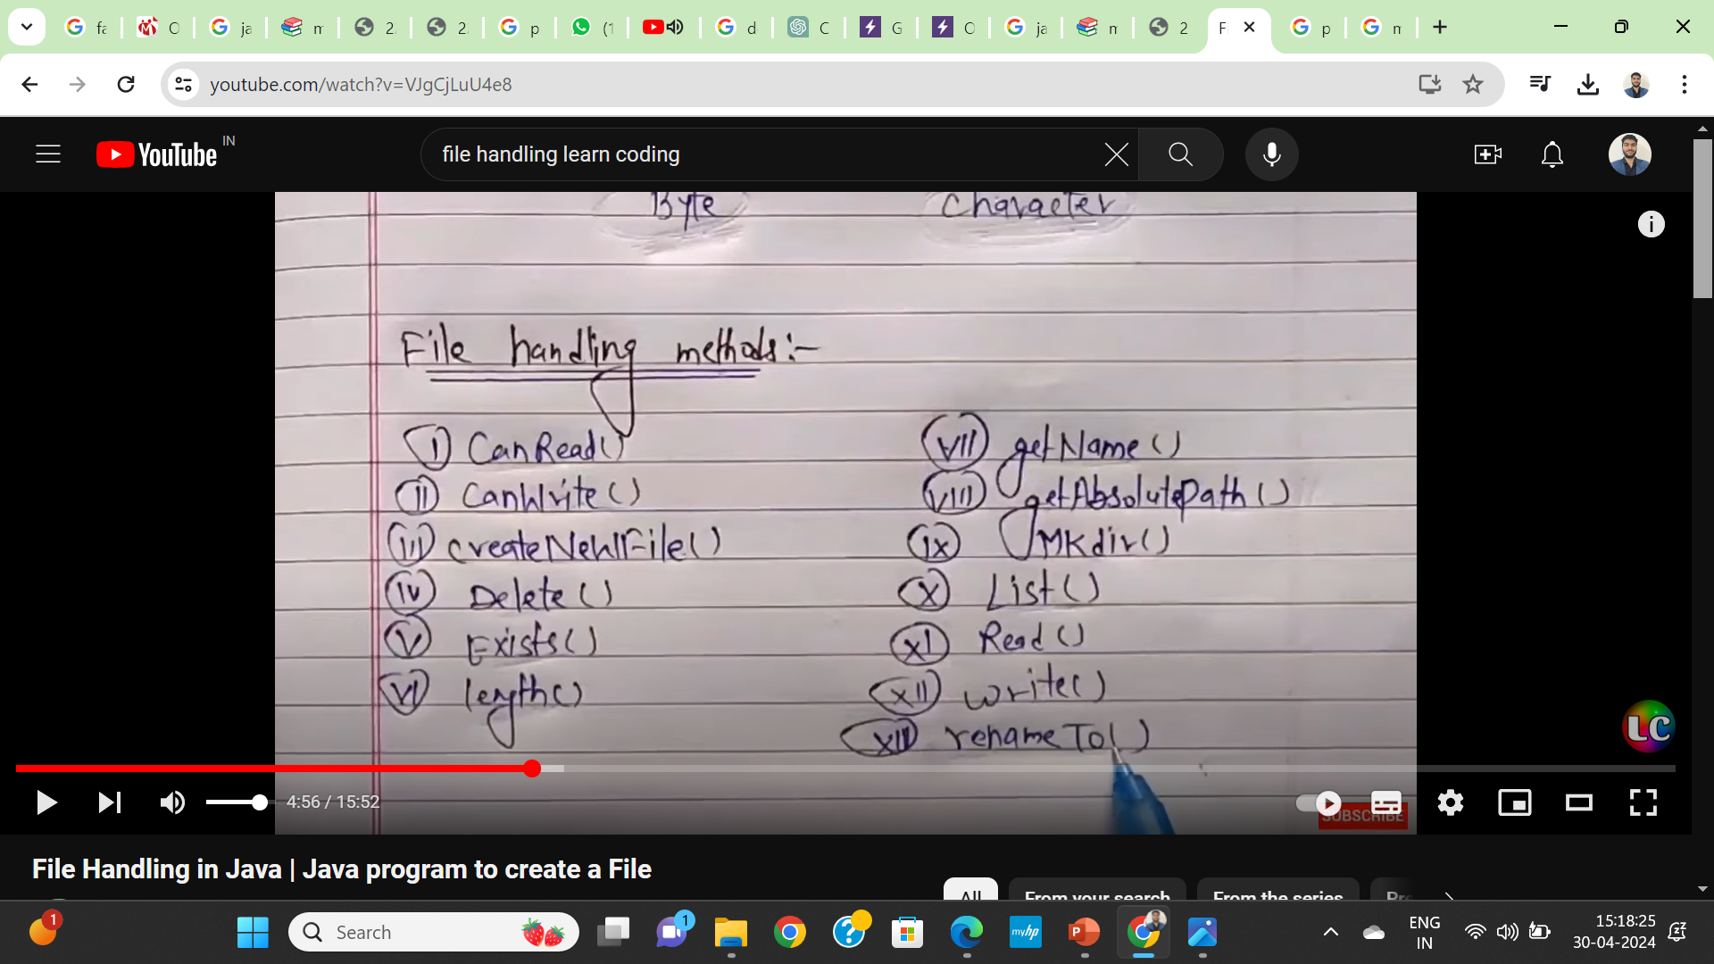

Slide 43
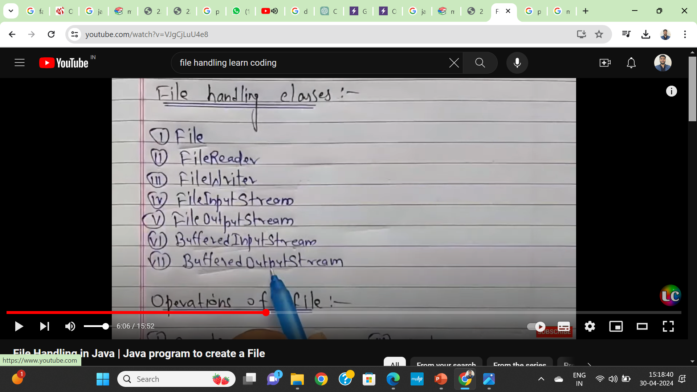

Slide 44
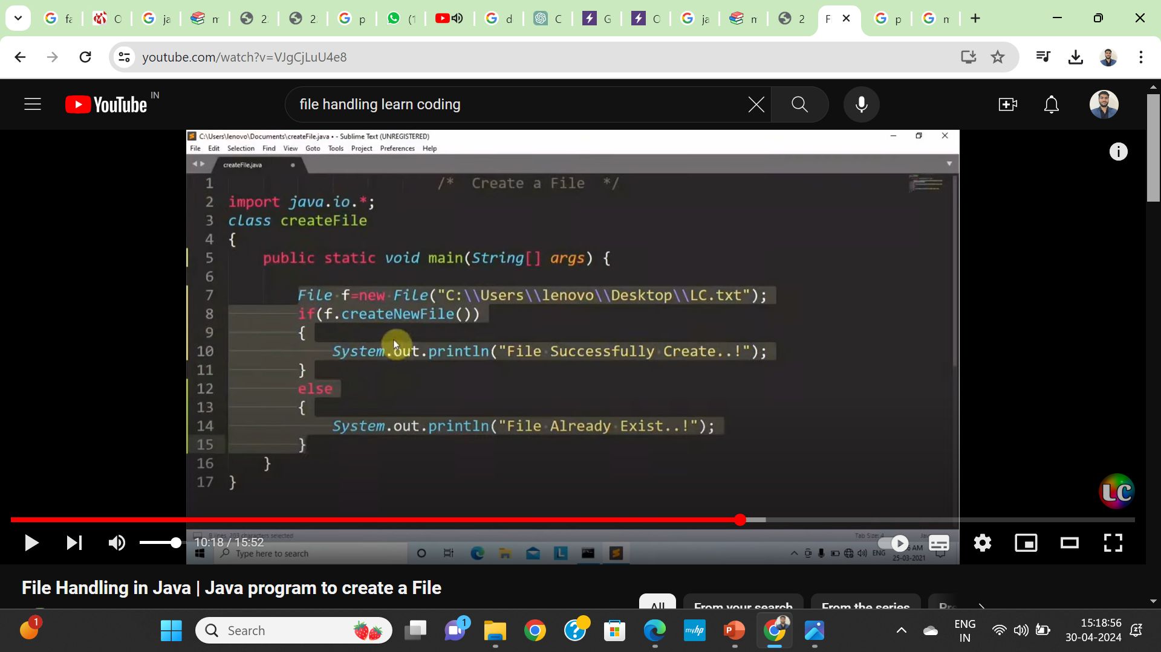

Slide 45
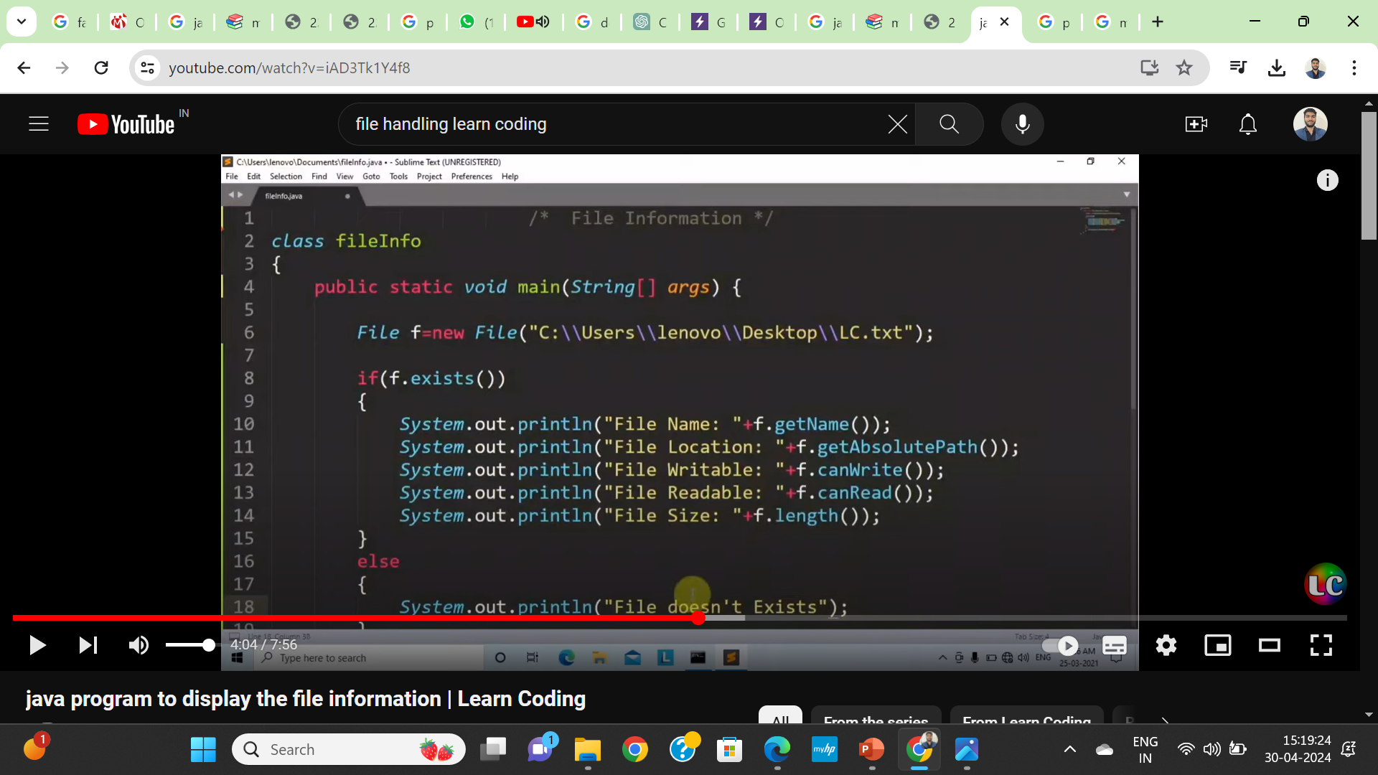

Slide 46
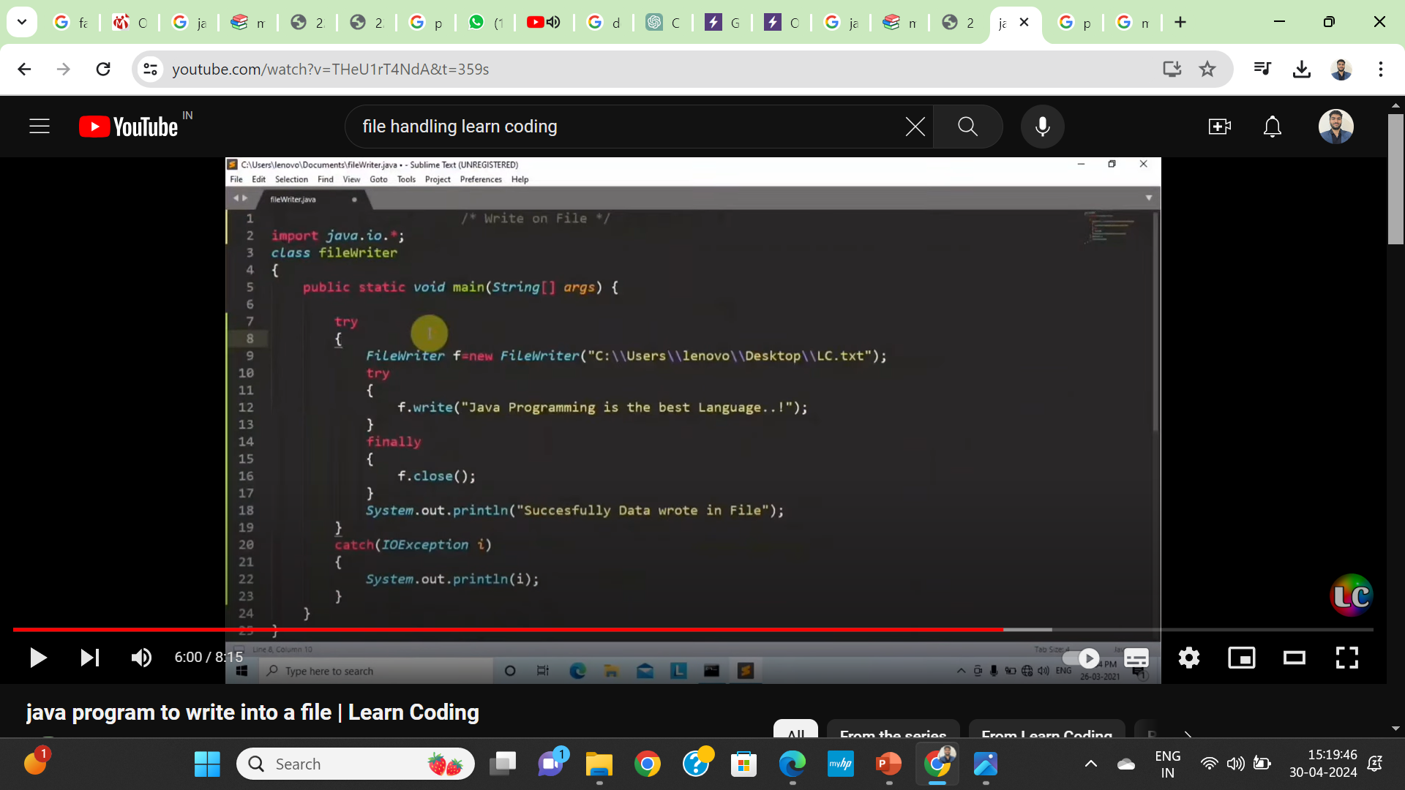

Slide 47
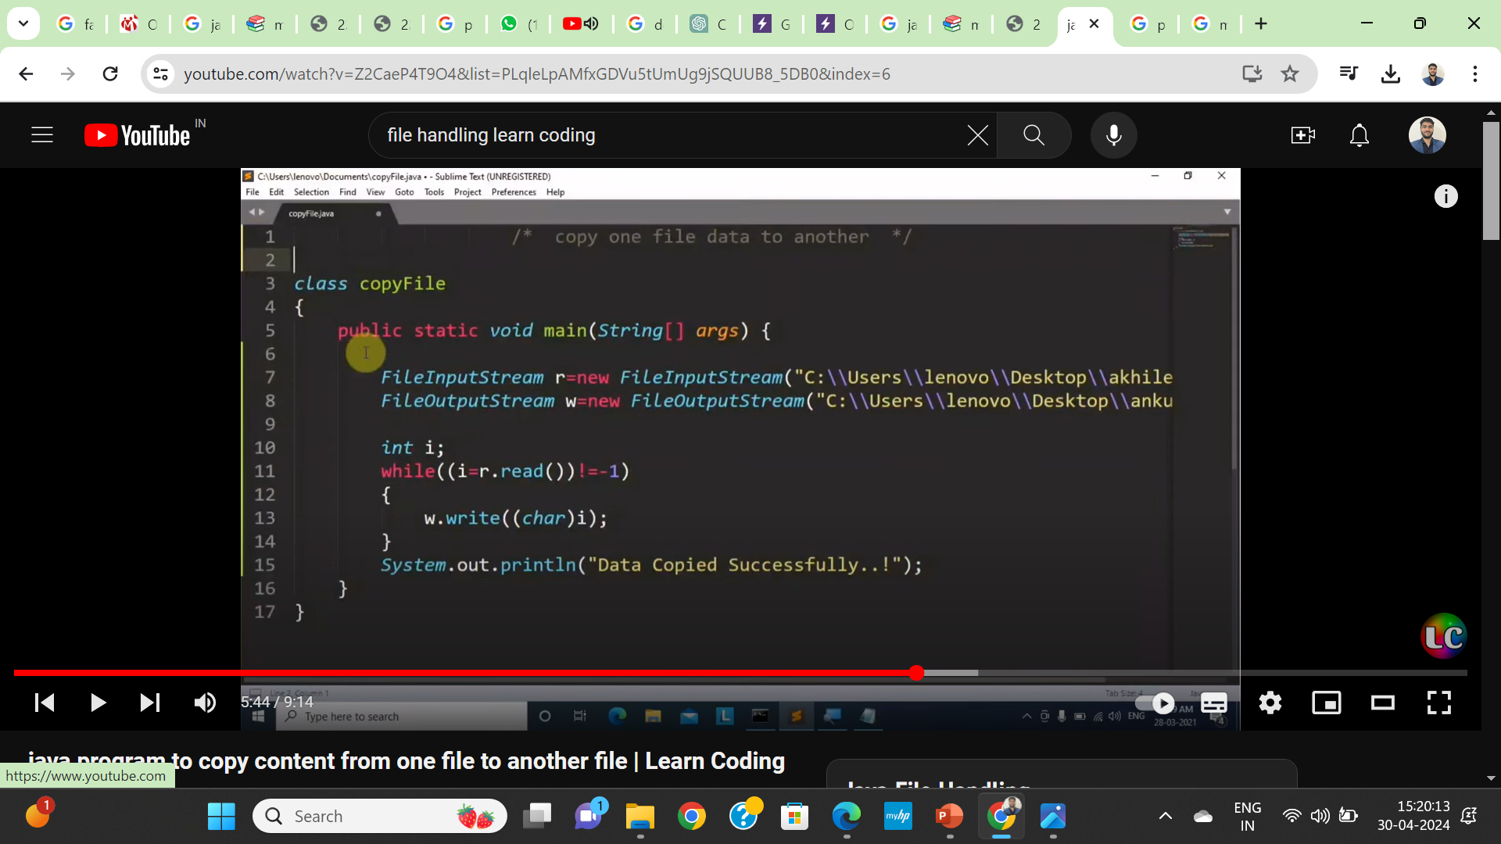

Slide 48
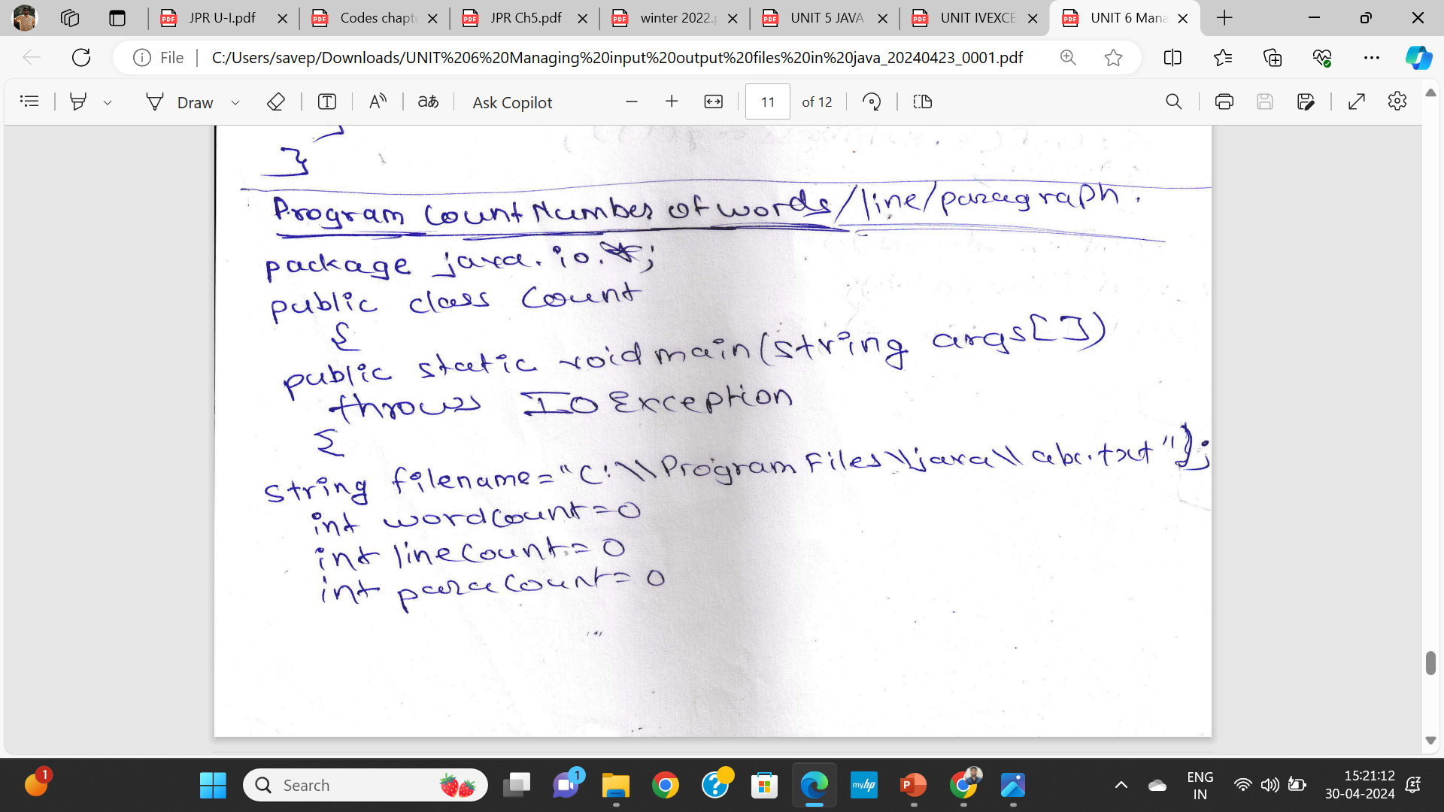

Slide 49
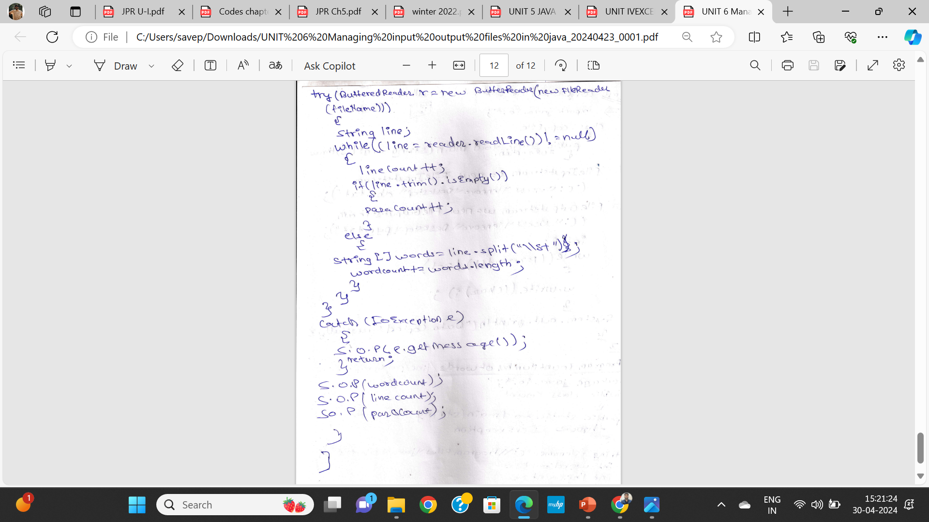

Slide 50
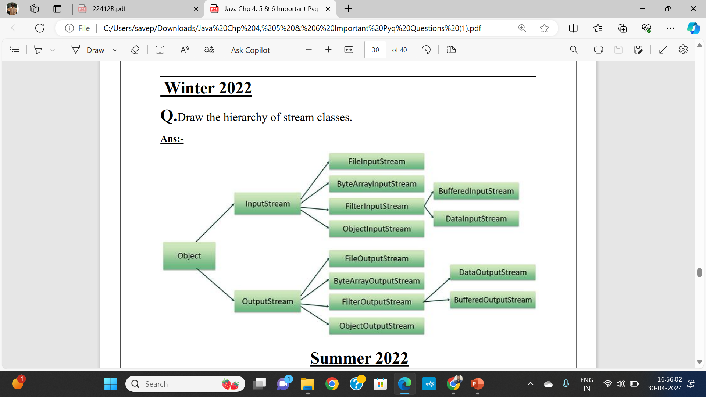

Slide 51
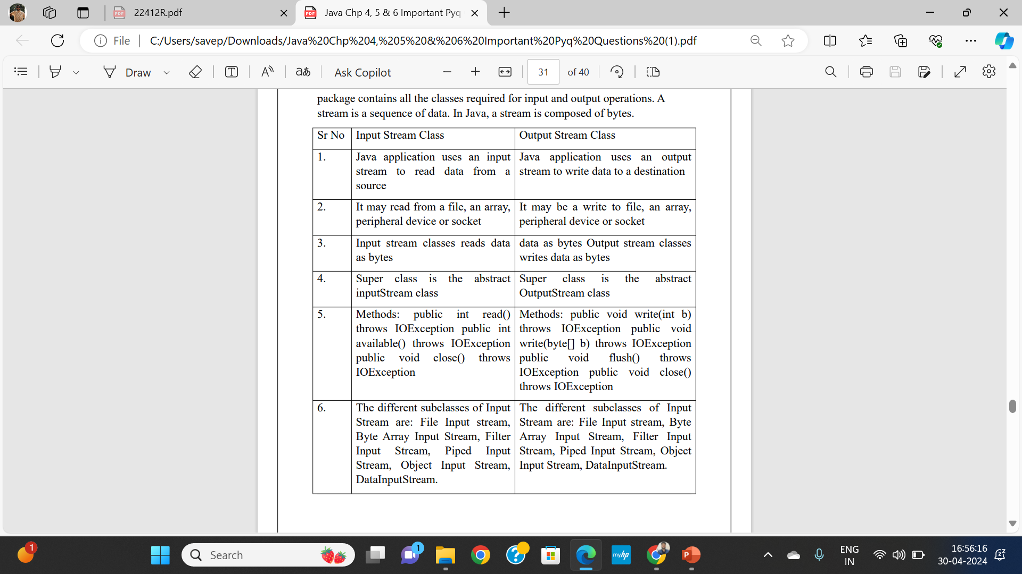

Slide 52
Aspect | Character Streams | Byte Streams
Data Handling | Handle character-based data | Handle raw binary data
Representation | Classes end with "Reader" or "Writer" | Classes end with "InputStream" or "OutputStream"
Suitable for | Textual data, strings, human-readable info | Non-textual data, binary files, multimedia
Character Encoding | Automatic encoding and decoding | No encoding or decoding
Text vs non-Text data | Text-based data, strings | Binary data, images, audio, video
Performance | Additional conversion may impact performance | Efficient for handling large binary data
Handle Large Text Files | May impact performance due to encoding | Efficient, no encoding overhead
String Operations | Convenient methods for string operations | Not specifically designed for string operations
Convenience Methods | Higher-level abstractions for text data | Low-level interface for byte data
Reading Line by Line | Convenient methods for reading lines | Byte-oriented, no built-in line-reading methods
File Handling | Read/write text files | Read/write binary files
Network Communication | Sending/receiving text data | Sending/receiving binary data
Handling Images/Audio/Video | Not designed for handling binary data directly | Suitable for handling binary multimedia data
Text Encoding | Supports various character encodings | No specific text encoding support

Slide 53
The end

